Slide 1

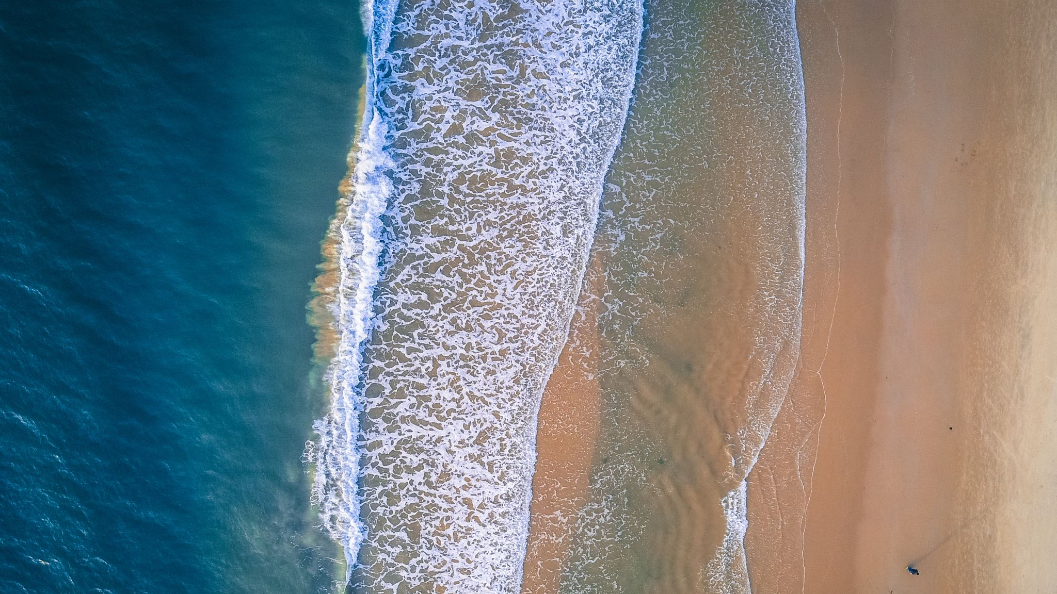



Introduction to running, visualizing, and calibrating the General Lake Model
Hilary Dugan, Robert Ladwig, Paul Hanson
GLEON 21

Slide 2
Find all material and data here
https://github.com/gsagleon/G21_GSA_workshop/tree/master/D_GLM

Slide 3
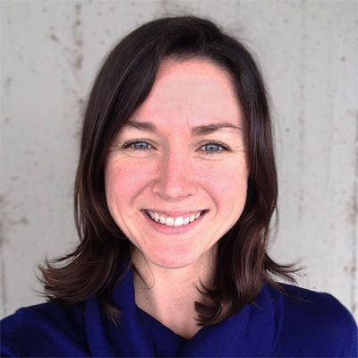
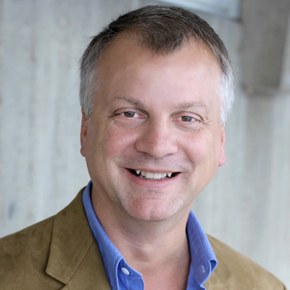
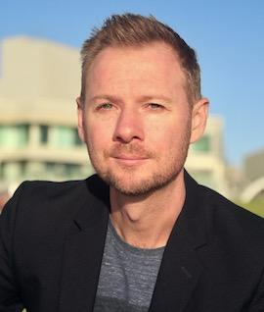
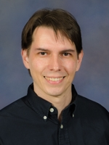
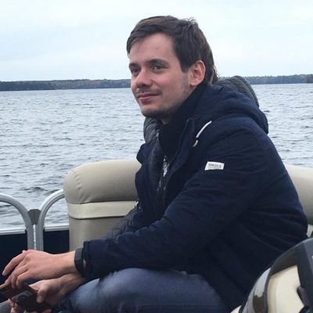
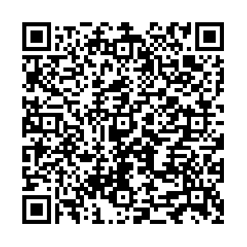
Who some of us are
Hilary Dugan
Assist. Prof. @ CFL UW-Madison
Paul C. Hanson
Research Prof. @ CFL UW-Madison
Matt Hipsey
Assoc. Prof. @ AED UWA Perth
Renato Figueiredo
Prof. @ ESE
Univ. of Florida
Robert Ladwig
Postdoc @ CFL UW-Madison
We’re around all week, so feel free to ask questions and engage on the GLM Slack channel →

Slide 4
Some acknowledgements
GLM was developed by Matt Hipsey, Louise Bruce, Casper Boon; further contributions by Brendan Busch, Jordi Prats, Quinn Thomas, Wentao Guo, Cayelan Carey
GLM3r: Jordan Read, Luke Winslow, Joseph Stachelek, Laura DeCicco, Hilary Dugan, Robert Ladwig
glmtools: Jordan Read, Luke Winslow, Jordan Stachelek, Stuart Jones, David Watkins, Hilary Dugan, Robert Ladwig, Tadhg Moore
GRAPLEr: Kensworth Subratie, Saumitra Aditya, Renato Figueiredo, Cayelan Carey, Paul Hanson
We probably missed some people. Sorry.

Slide 5

Scope of this workshop
At the end, you’ll be able to run, visualize and calibrate a lake model using Rstudio
On the way:
Introduction to numerical modeling
How does GLM work?
Glimpse of how the water quality model works
Which packages are available in R?
What are the plans for the future?
How can I contribute to the development?

Slide 6
Scope of this workshop
2-2:45
Introduction to modeling and GLM
Introduction to glmtools
3-3:45
Visualizing and calibrating GLM in R
Introduction to GRAPLEr
4-4:30
Current and future developments
Community involvement
Running GLM in R

Slide 7
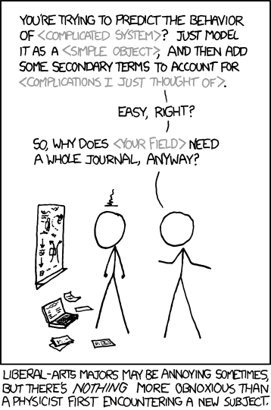
Crash course: Numerical Modeling
Models are simplified reflections of reality
Deterministic (events at next time step depend on events from previous time step)
and describe processes with mathematical equations
that are either based on empirical knowledge or physical principles
Numerical models need time and space discretization
As well as initial data (to start from) and boundary data (as driving data)
xkcd

Slide 8

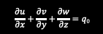
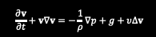
Crash course: Numerical Modeling
Conservation of mass (continuity)
Inflow(s)= outflow(s)
Mass cannot be created or destroyed
Conservation of momentum
Velocity based on balances of forces (gravity, pressure, friction, earth-rotation)
State of the environment
Model
$$\frac{∂u}{∂x}+\frac{∂v}{∂y}+\frac{∂w}{∂z}=q_{0}$$
$$\frac{∂v}{∂t}+v∇v=−\frac{1}{ρ}∇p+g+υ∆v$$
State of the system
This Photo by Unknown Author is licensed under CC BY

Slide 9
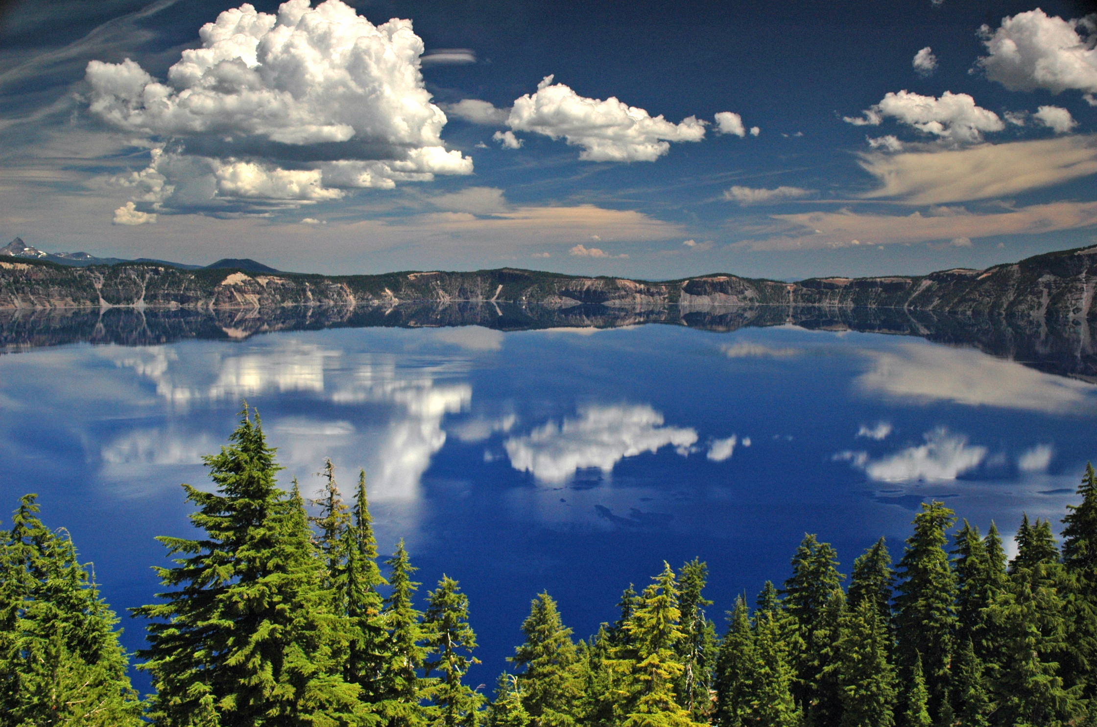
This Photo by Unknown Author is licensed under CC BY-SA

Slide 10
Concentration
Volume
Surface layer
Bottom layer
Sediment area
This Photo by Unknown Author is licensed under CC BY-SA

Slide 11
Crash course: Numerical Modeling
Most are bookkeeping exercises to keep inflow = outflow (mass-balance)
Surface layer
c₁
V₁
Concentration
Volume
A₁
Area dividing the two zones
c₂
V₂
Bottom layer
Sediment area
A₂

Slide 12
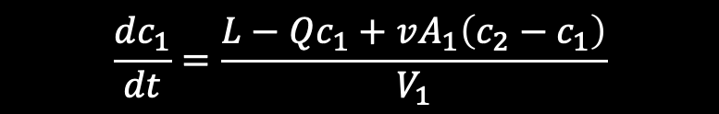
Crash course: Numerical Modeling
Most are bookkeeping exercises to keep inflow = outflow (mass-balance)
loading
flushing
L
Q
c₁
V₁
$$\frac{dc_{1}}{dt}=\frac{L−Qc_{1}+vA_{1}\left(c_{2}−c_{1}\right)}{V_{1}}$$
diffusion
v
A₁
c₂
V₂
A₂

Slide 13
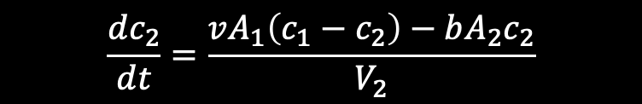
Crash course: Numerical Modeling
Most are bookkeeping exercises to keep inflow = outflow (mass-balance)
L
Q
c₁
V₁
$$\frac{dc_{1}}{dt}=\frac{L−Qc_{1}+vA_{1}\left(c_{2}−c_{1}\right)}{V_{1}}$$
v
A₁
$$\frac{dc_{2}}{dt}=\frac{vA_{1}\left(c_{1}−c_{2}\right)−bA_{2}c_{2}}{V_{2}}$$
c₂
V₂
A₂
burial
b

Slide 14

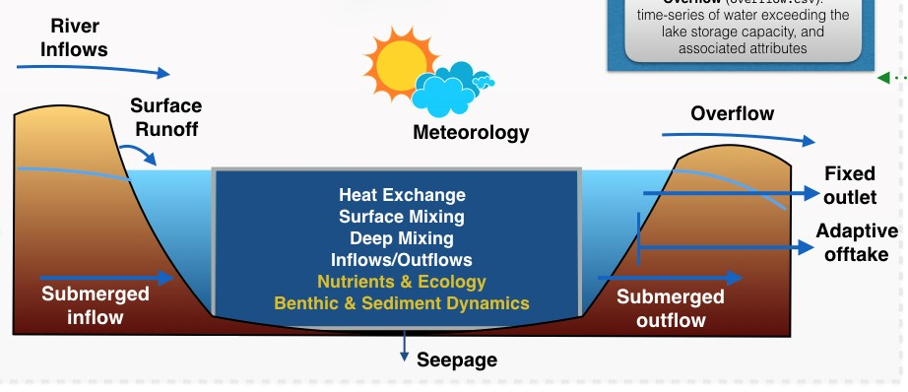
Introduction to GLM
Supported as a project within GLEON
Developed by Matt Hipsey, Louise Bruce and Casper Boon at UWA
Designed to operate with the Aquatic EcoDynamics Model Libraries (AED) → water quality model
Languages: C (and Fortran for AED)
Freely available as open-source program
https://github.com/AquaticEcoDynamics/GLM

Slide 15
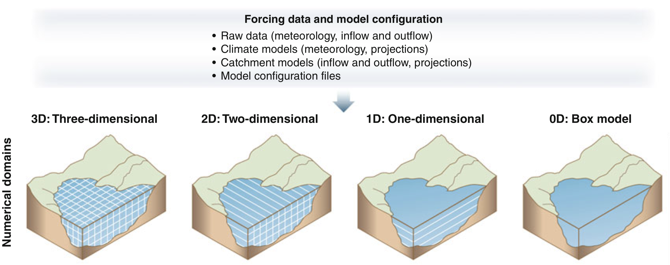
Introduction to GLM
Vertical one-dimensional model (spatially homogenous lake)
Trolle (2012)

Slide 16
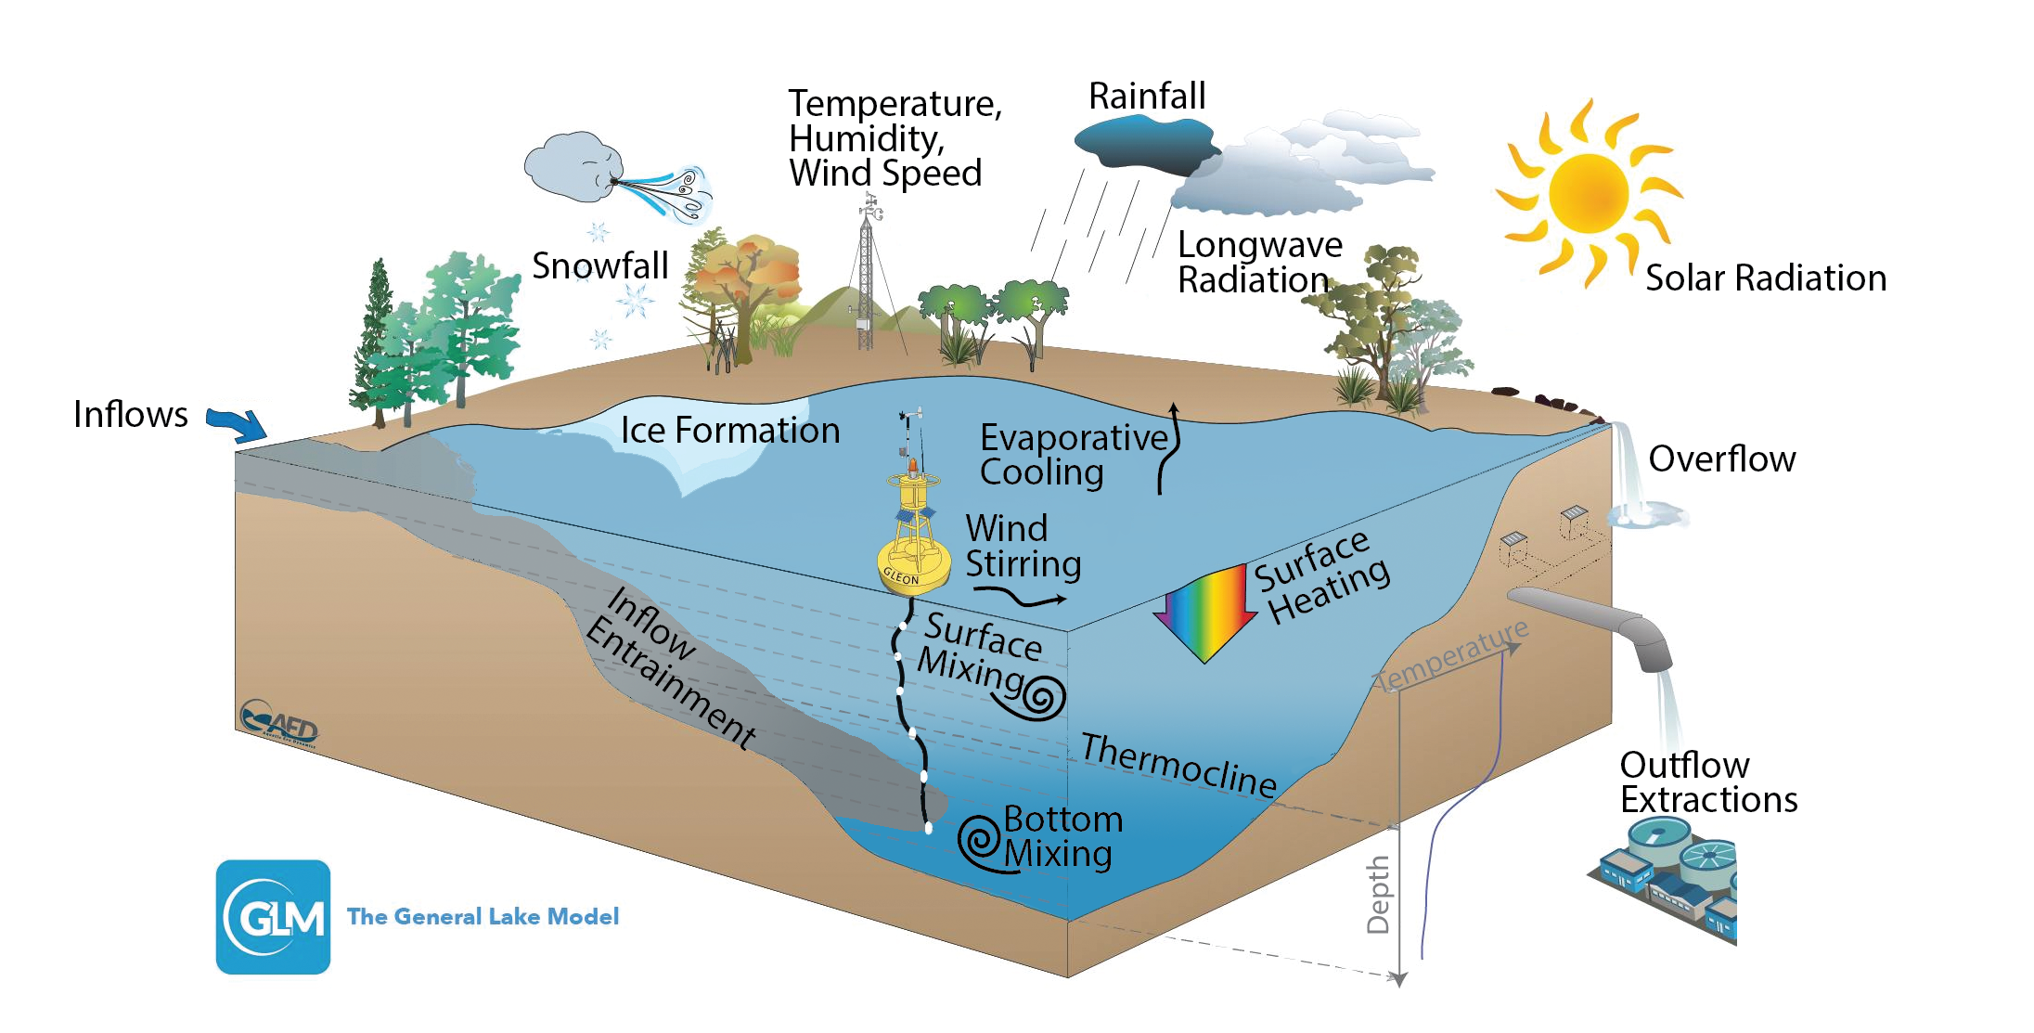
Introduction to GLM

Slide 17
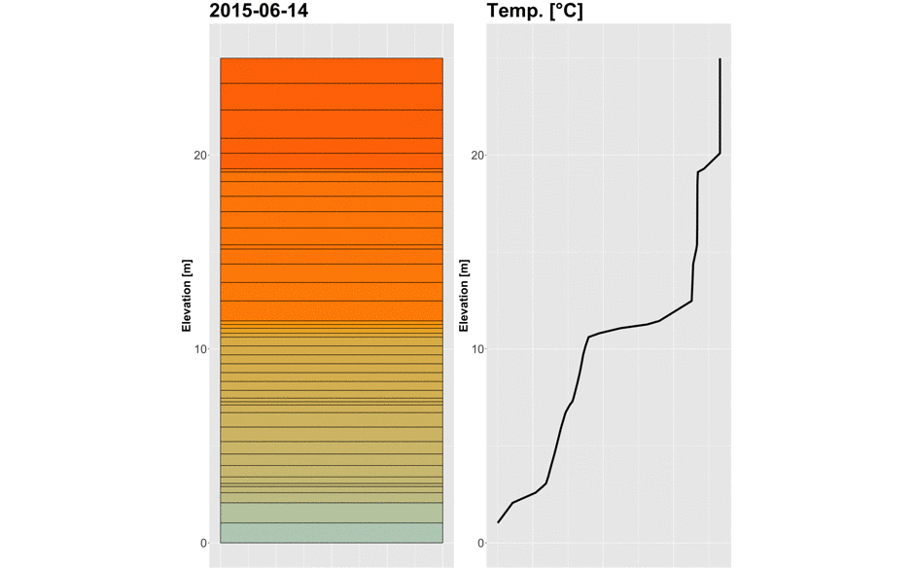
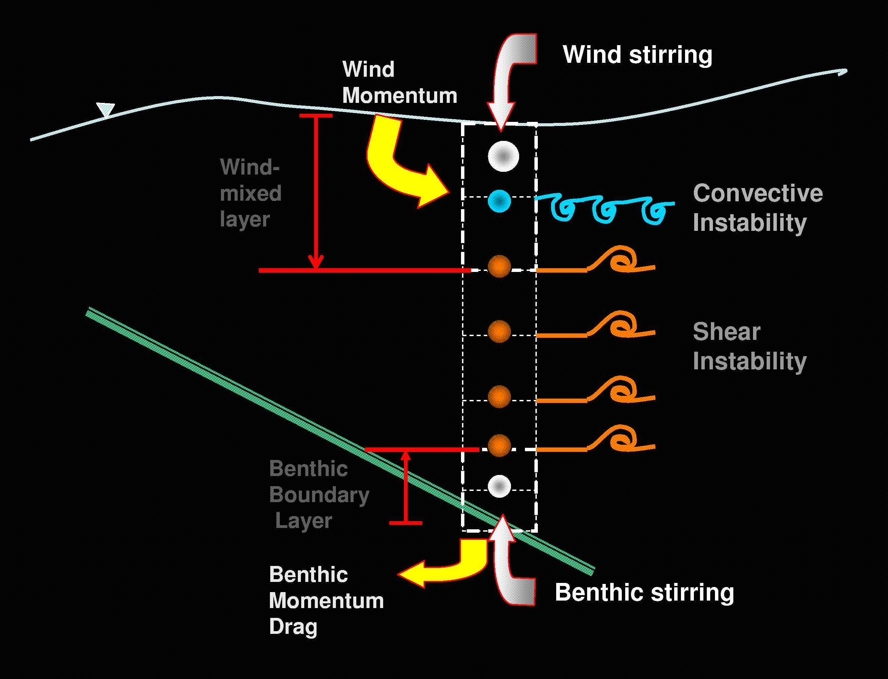
Surface energy fluxes
Inflow(s)
Introduction to GLM
Flexible grid: thickness of layers
Vertical mixing by stirring, convective overturn and shear
mixing

Slide 18
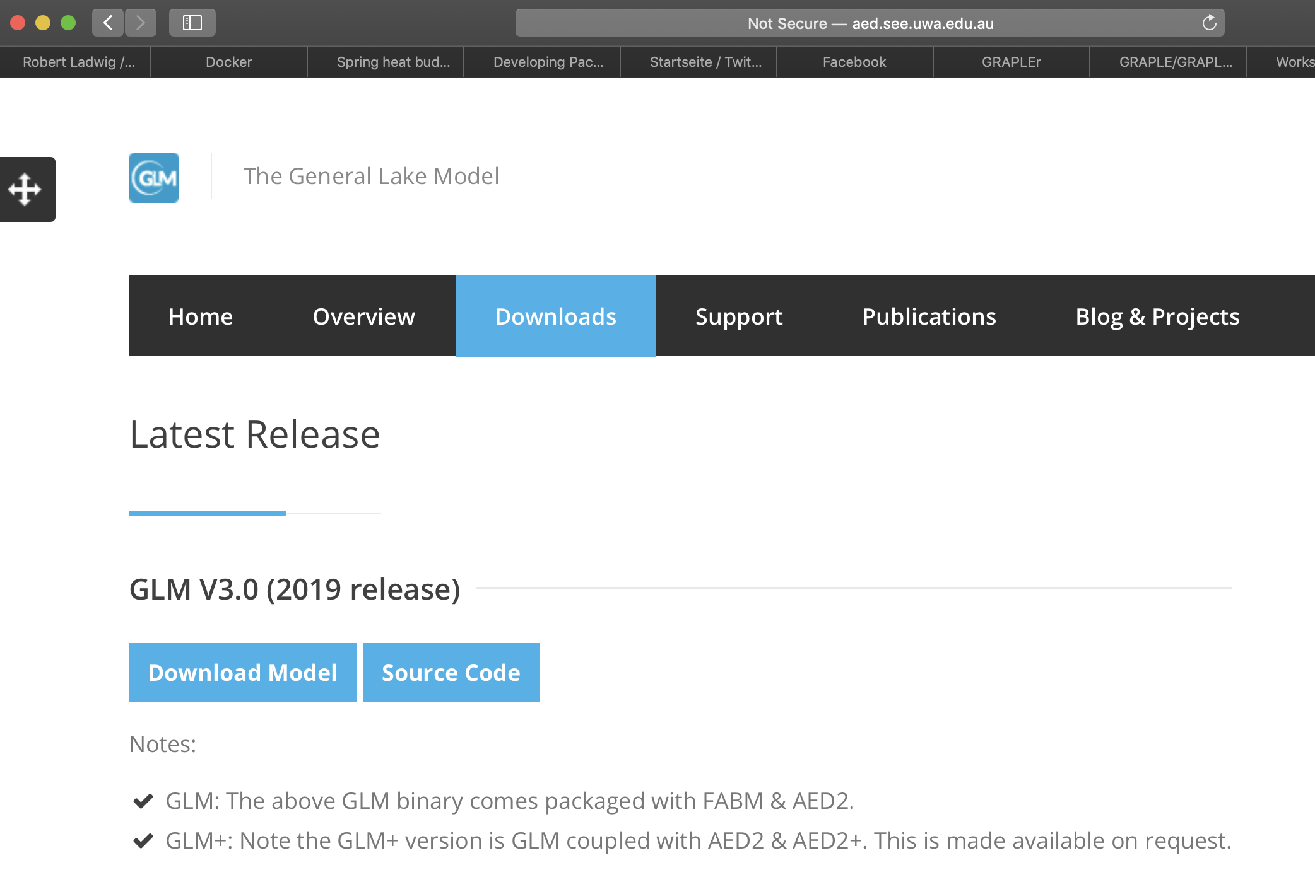
Introduction to GLM
Installing GLM:
Download software package via AED GLM website: http://aed.see.uwa.edu.au/research/models/GLM/latest_release.html (precompiled binaries)
Source code and compilation instructions are available, accessible via the GitHub repository - https://github.com/AquaticEcoDynamics/GLM
GLM3r in R (devtools::install_github(“GLEON/GLM3r”)

Slide 19
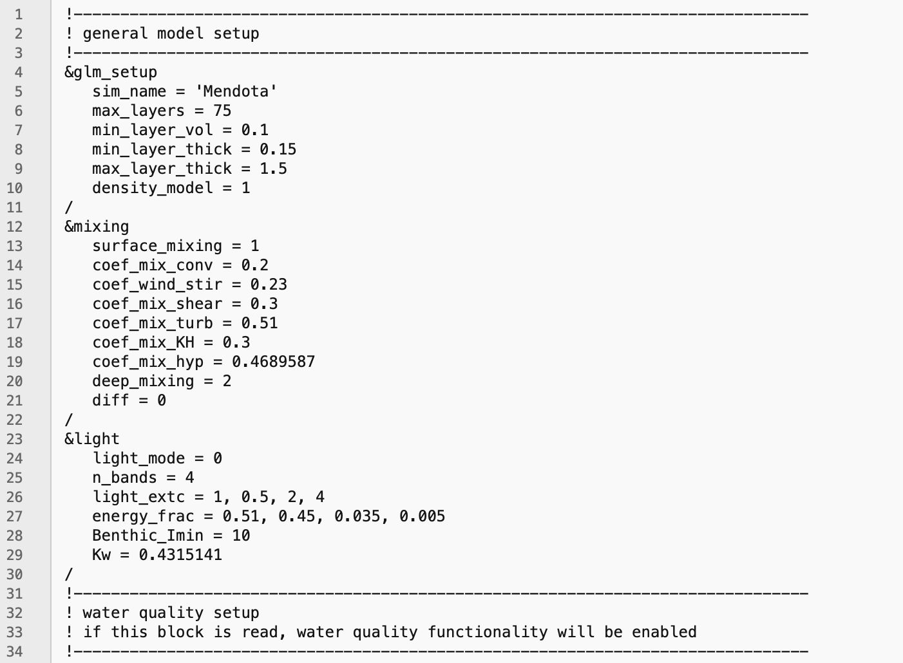
Introduction to GLM
You’ve installed GLM (executables), what now?
Main tool: glm3.nml file

Slide 20
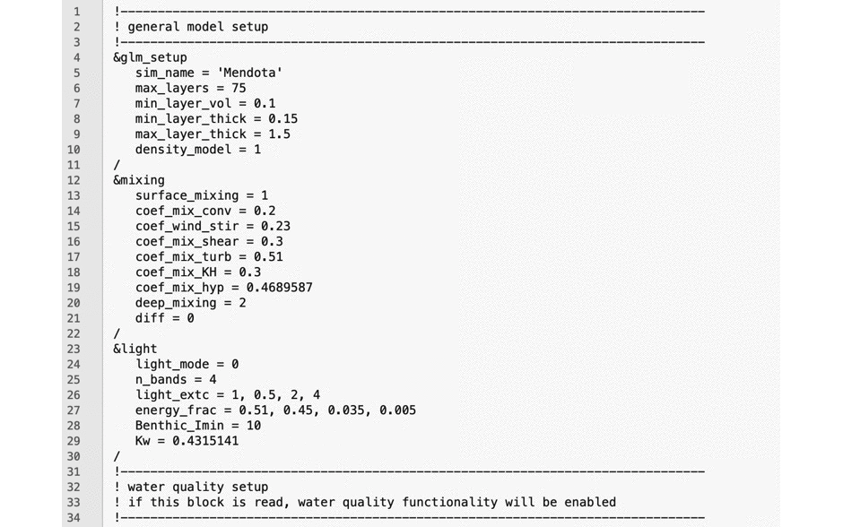
Introduction to GLM
Main tool: glm3.nml file
Ordered into blocks
Begin with: &
End with: /
Includes model setup and relative paths to water quality and driver data
GLM executable needs the setup file

Slide 21
Introduction to GLM : setting up your model
glm3.nml file
Define the morphometry
Area-depth relationship (hypsography)
Define what you want to simulate
State variables (temperature, salinity, etc.)
Grid resolution and time step
Define external environment
Boundary conditions (inflows, meteorology, outflows)
Provide an initial condition
Start your simulation
&glm_setup: General simulation info
&wq_setup: Water quality
&time: Time control
&morphometry: Lake morphometric information
&output: Output file details
&init_profiles: Initial vertical profiles
&meteorology: Surface forcing and meeorology
&inflows: Information about inflowing rivers
&outflows: Information about outflows
&light: Information about light climate

Slide 22
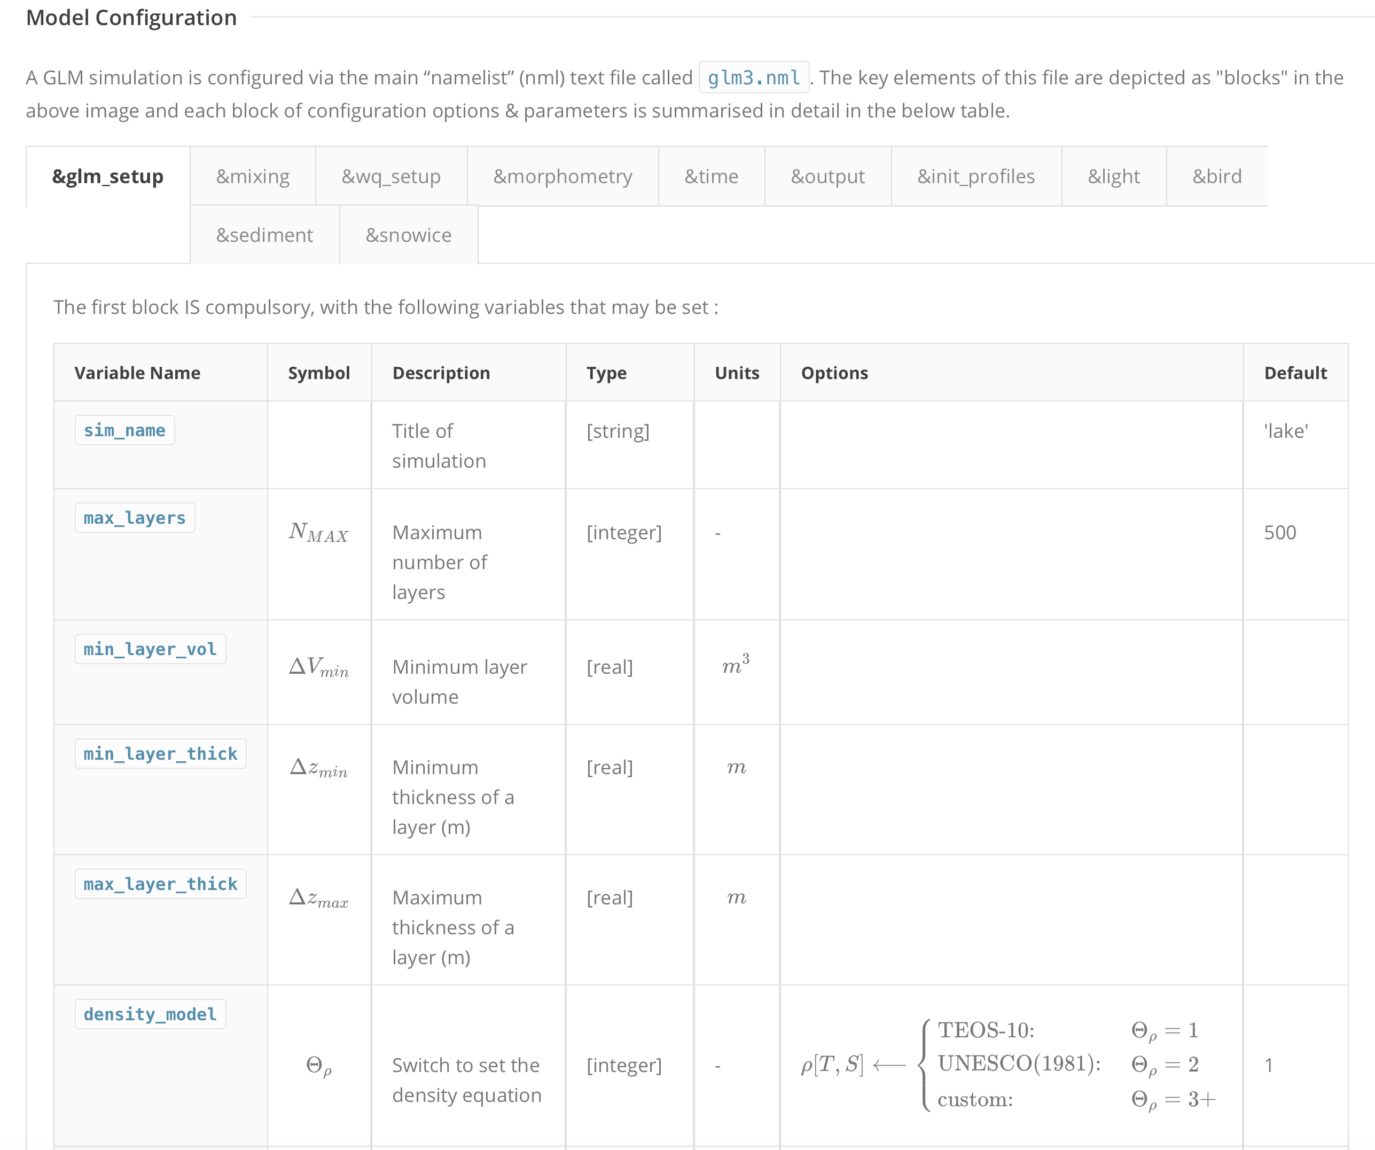
Introduction to GLM : setting up your model
GLM Online documentation
http://aed.see.uwa.edu.au/research/models/GLM/getting_started.html
Describes variable names
Gives units
Shows options
Provides a default value

Slide 23
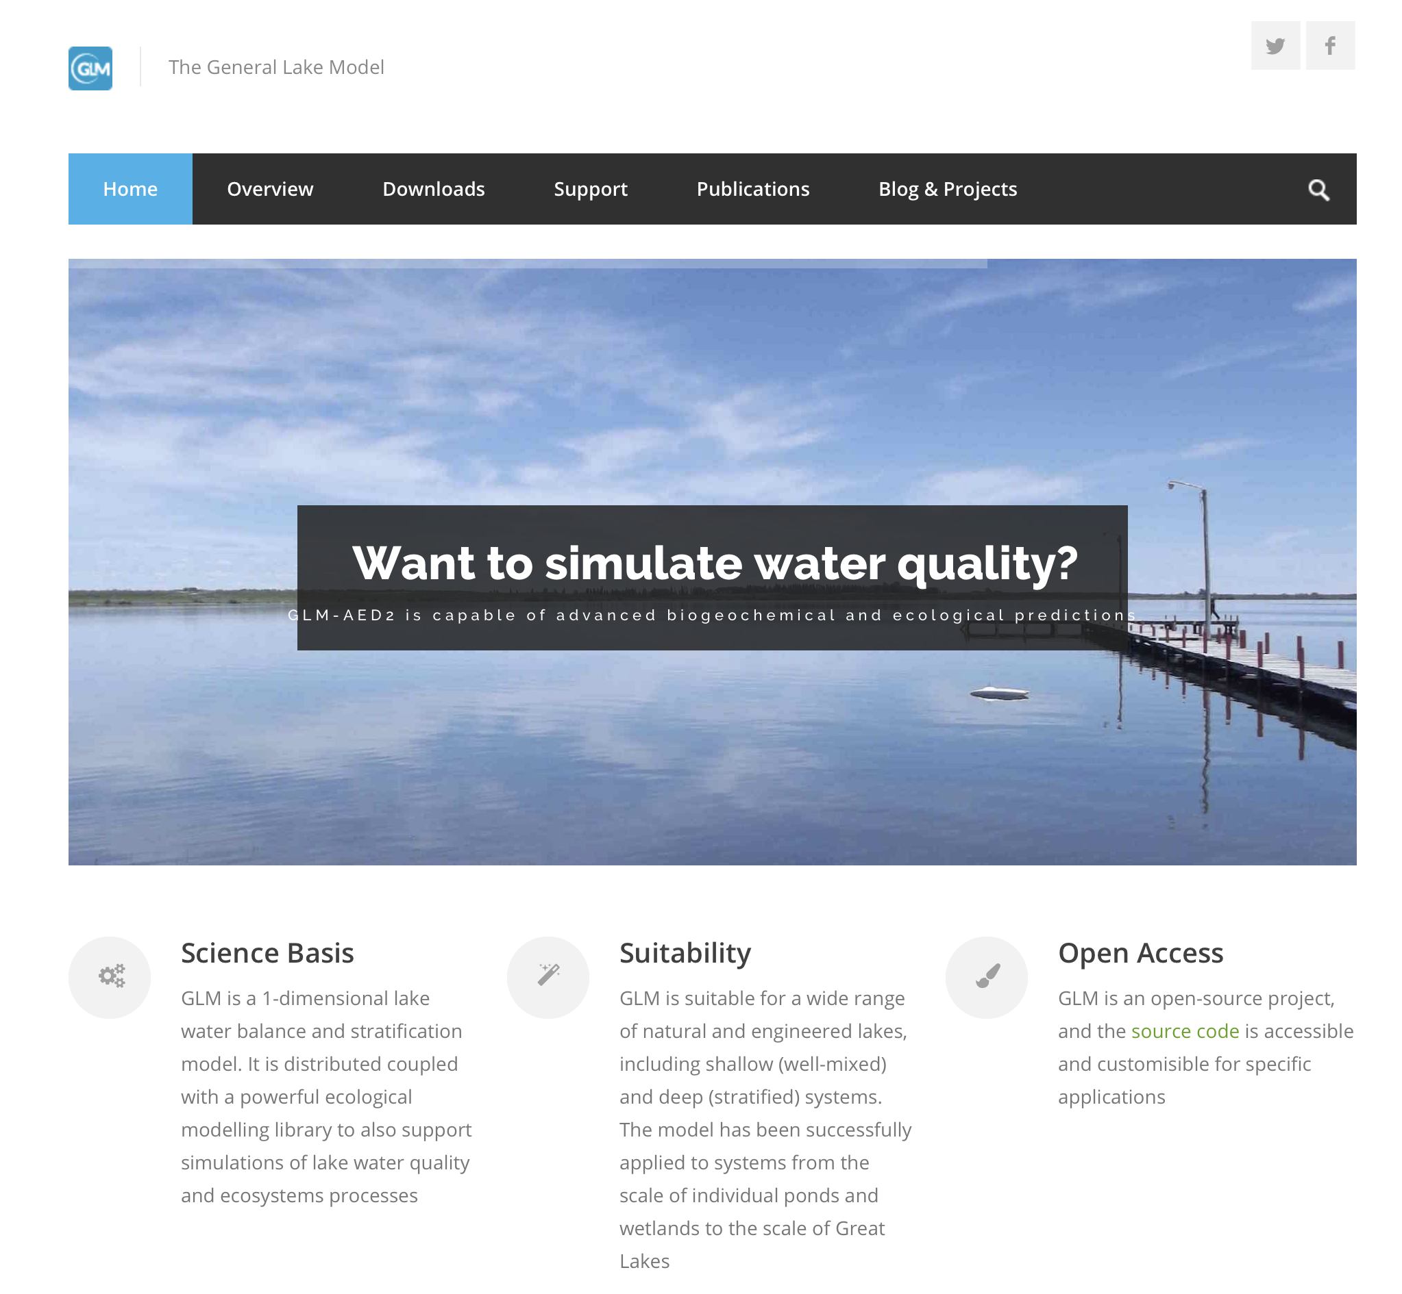
Introduction to GLM
Homepage: http://aed.see.uwa.edu.au/research/models/GLM/
Download newest versions of GLM (currently v.3.0.5)
Find support and help in Slack

Slide 24

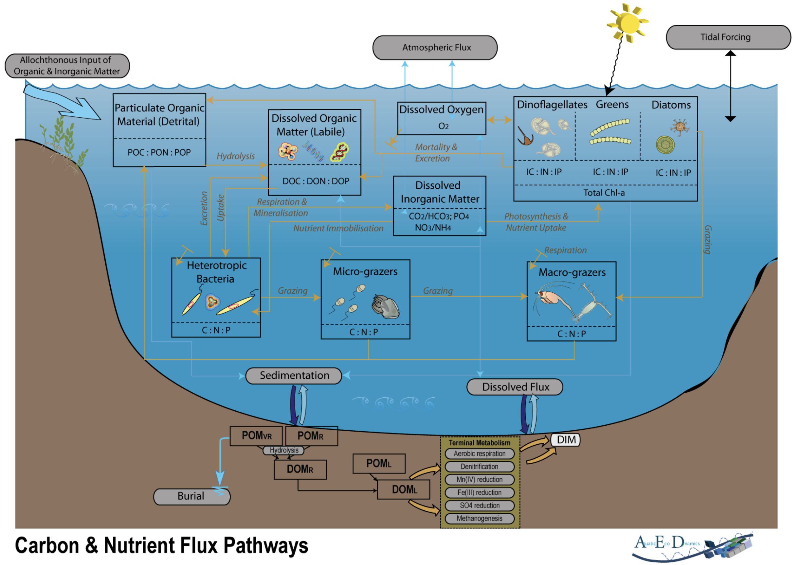




















Sneak peek: Water Quality
Aquatic Ecosystem Modelling Library (AED2)
Consists of several modules to conceptualize individual ecosystems, eg:
oxygen, nitrogen, phosphorus, phytoplankton
sediment biogeochemistry
benthic communities
GLM was designed to interact with AED2
CORE
AED2
ADVANCED
AED2+

Slide 25
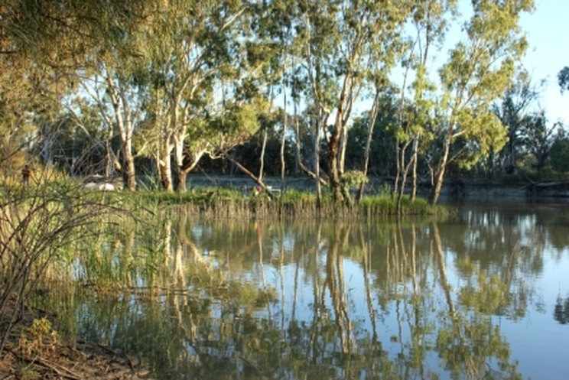
New features in v.3.X
Sediment-depth zones and zone-specific sediment heating, and biogeochemistry
Shallow lakes, ponds & wetland simulations (incl. drying out)
Wind-sheltering options
Seepage model
Ice initialization
Light model
Hipsey, M.R., Bruce, L.C., Boon, C., Busch, B., Carey, C.C., Hamilton, D.P., Hanson, P.C., Read, J.S., de Sousa, E., Weber, M. and Winslow, L.A., 2019. A General Lake Model (GLM 3.0) for linking with high-frequency sensor data from the Global Lake Ecological Observatory Network (GLEON). Geoscientific Model Development, 12(1), pp.473-523.

Slide 26
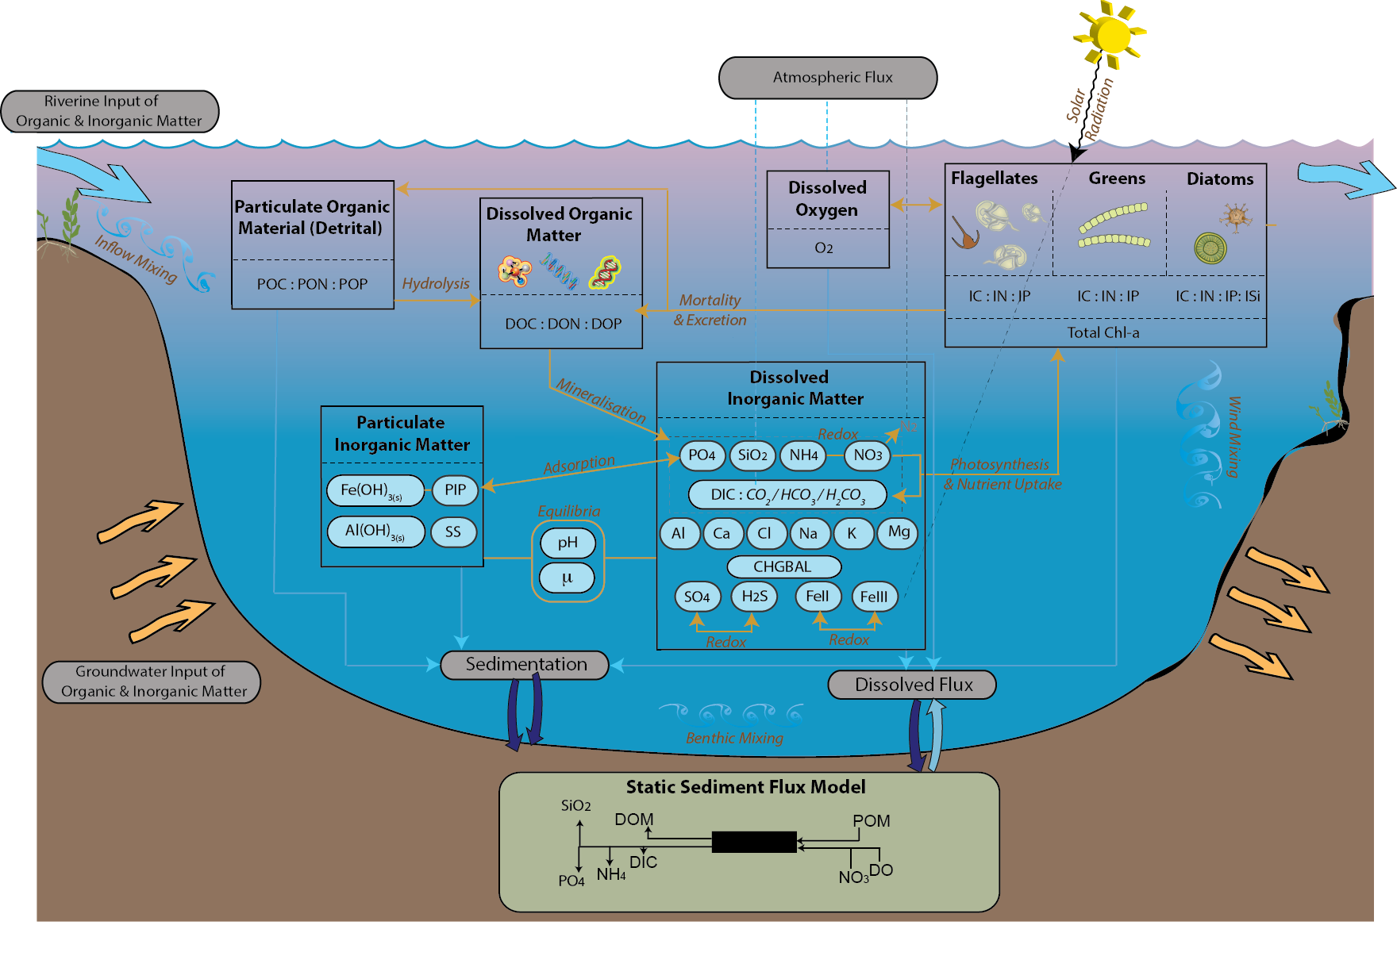
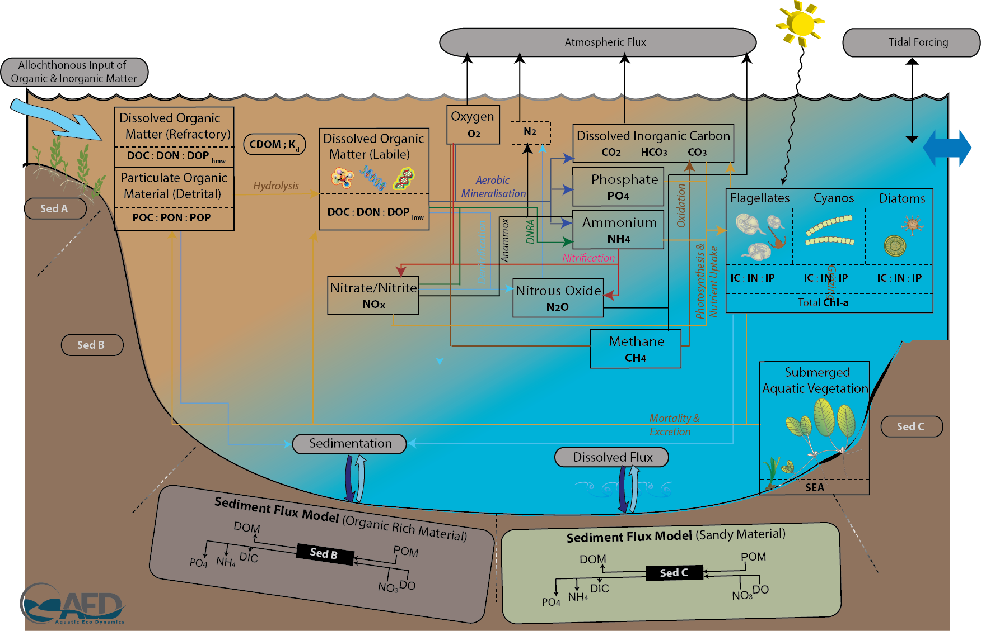
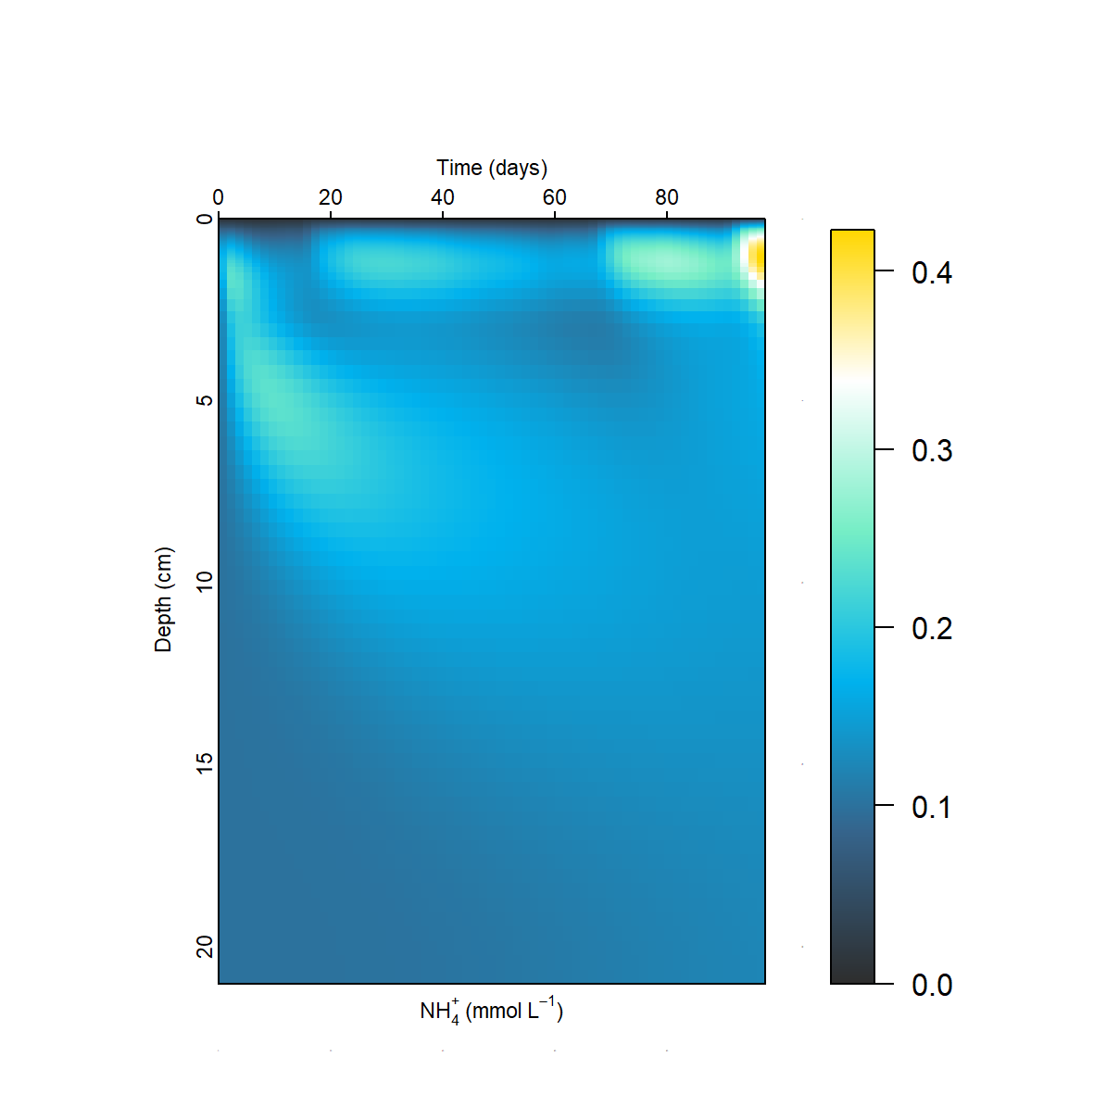
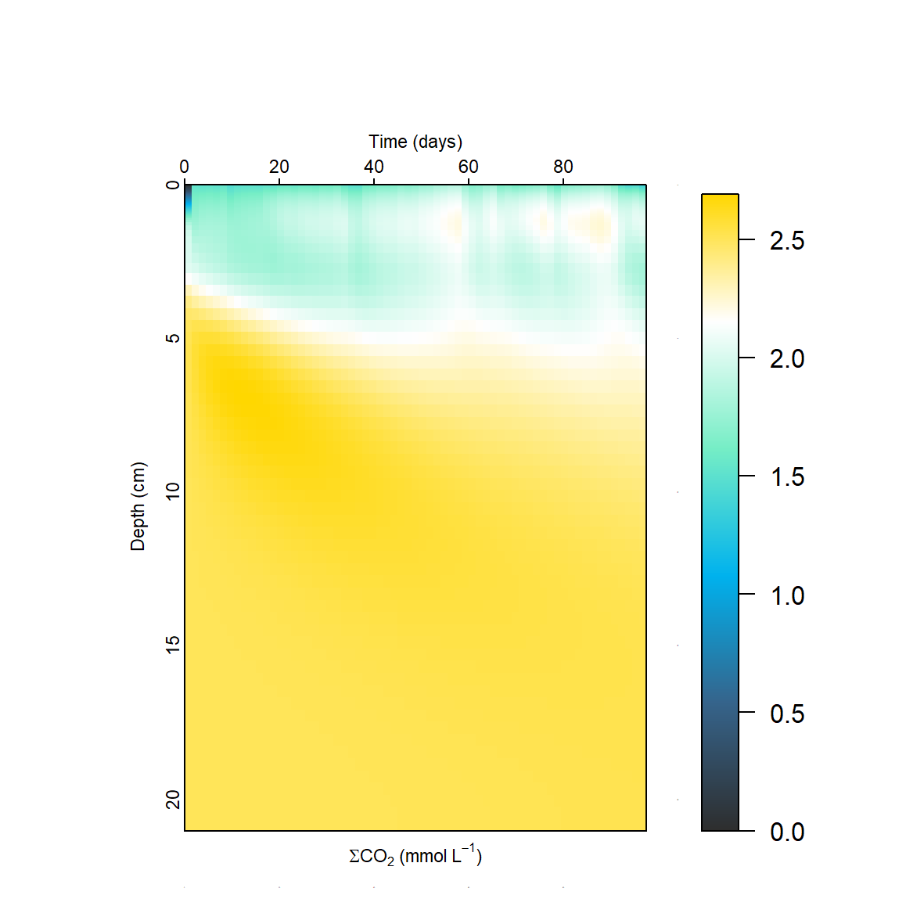
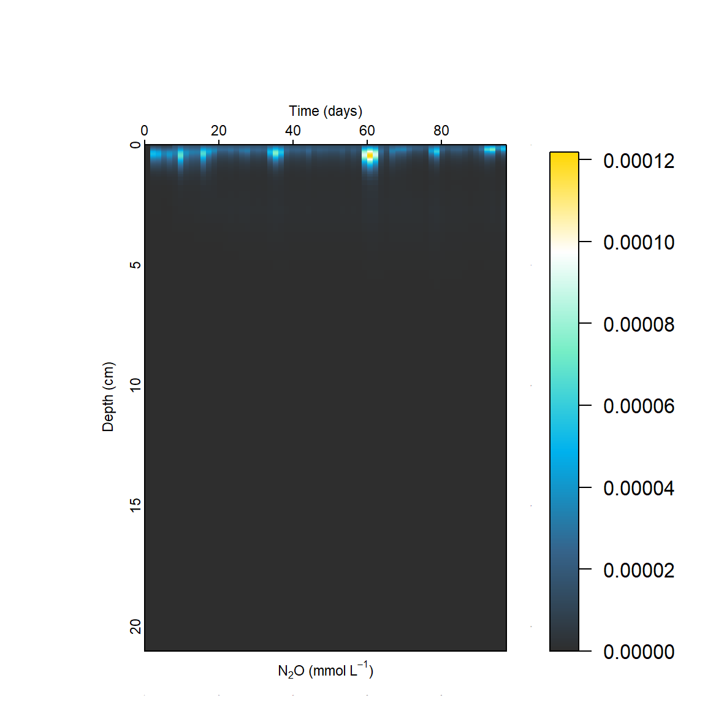
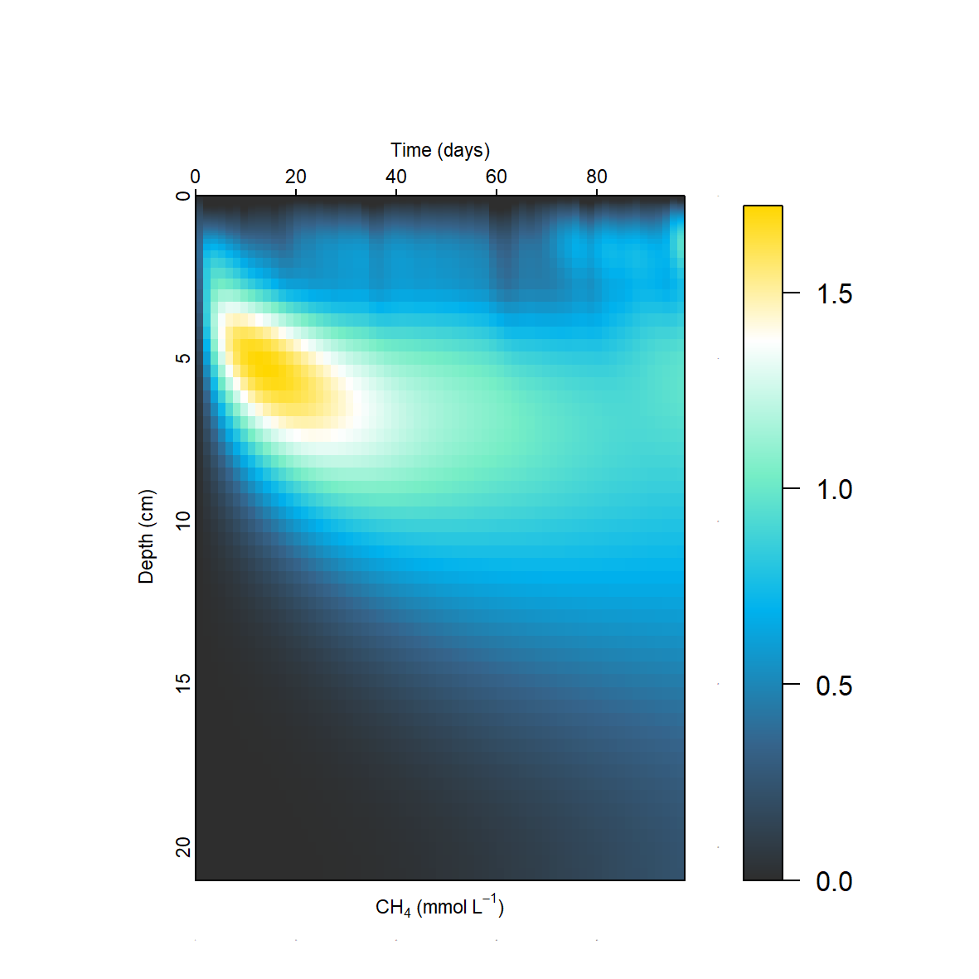
New features in v.3.X
Water Quality updates (AED2 / AED2+) :
GHGs (N2O, CH4, CO2)
Benthic productivity (MPB, MAC, MAG)
Mussels (BIV)
Geochemistry (GEO)
Sediment diagenesis (SDG)
NH₄
CO₂
N₂O
CH₄

Slide 27
GLM R-Packages
GRAPLEr
glmtools
GLM3r
Distributed computing system
Run multiple GLM simulations
e.g. scenario modeling
Changing model setup
Visualizing results
Physical derivatives
Calibration
Runs GLM in R (version 3.0.5)

Slide 28
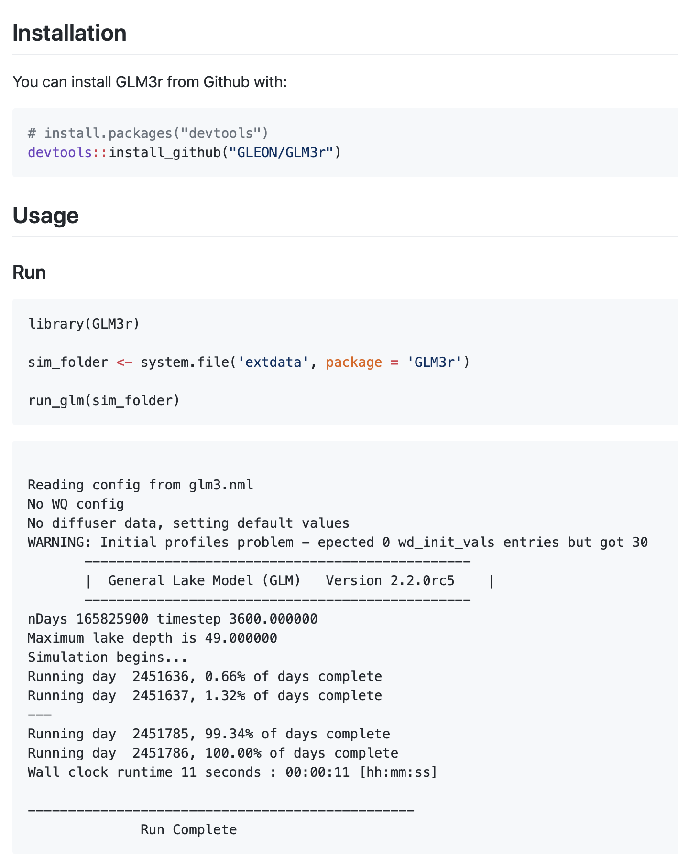
GLM3r
(big) Package that contains executables for Windows, Linux and macOS
Current version: 3.0.5
Runs GLM in R (with screen output)
Also provides version number
3.0.5

Slide 29
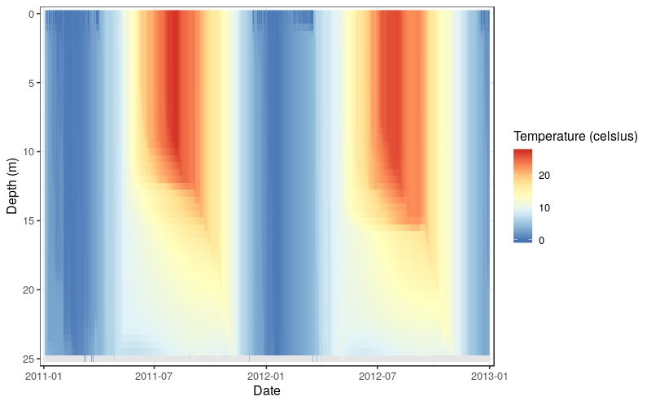
glmtools
Either from github or from GRAN (USGS-R’s alternative to CRAN)
Offers lots of functionalities
Manipulate model setup
Retrieve data from output (evaporation, temperature data, …)
Compare observed to simulated data
Visualize results (contour plots)
New features:
Overhauled visualization (ggplot2)
Automatic calibration

Slide 30
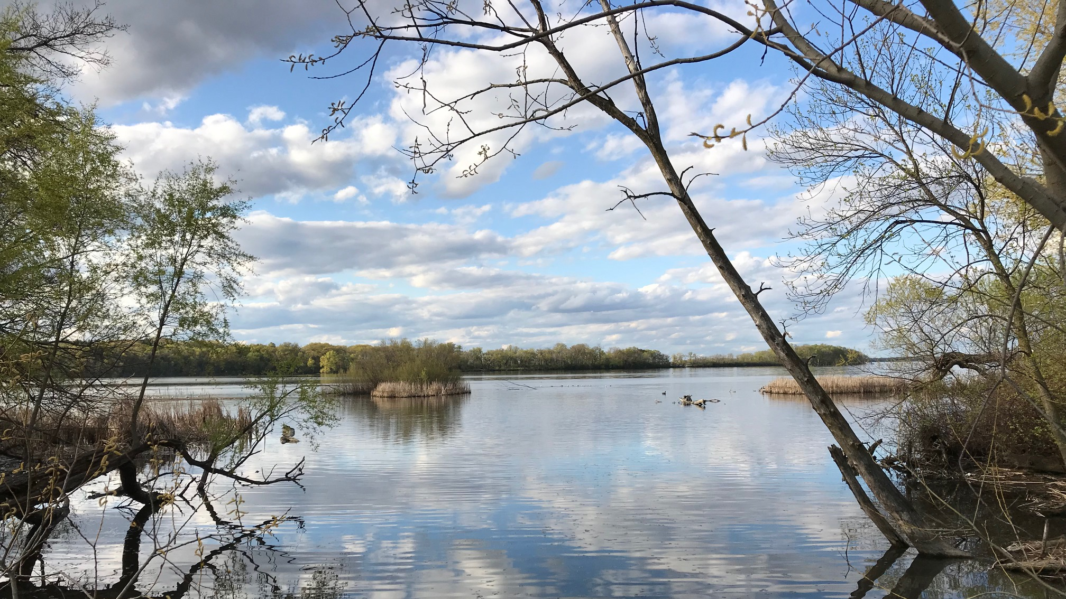
Run GLM in R

Slide 31

Break

Slide 32
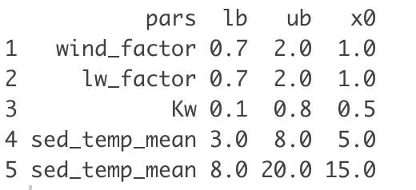

glmtools: calibration
get_calib_periods(): calibration
Template: your specific lake file
glm3.nml
glm4.nml
get_calib_setup(): variables
lower boundary
upper boundary
initial guess
parameter
Identified as sensitive by global lake modeling project ISIMIP
Sediment heat mean temperatures to improve vertical water temperature fit

Slide 33
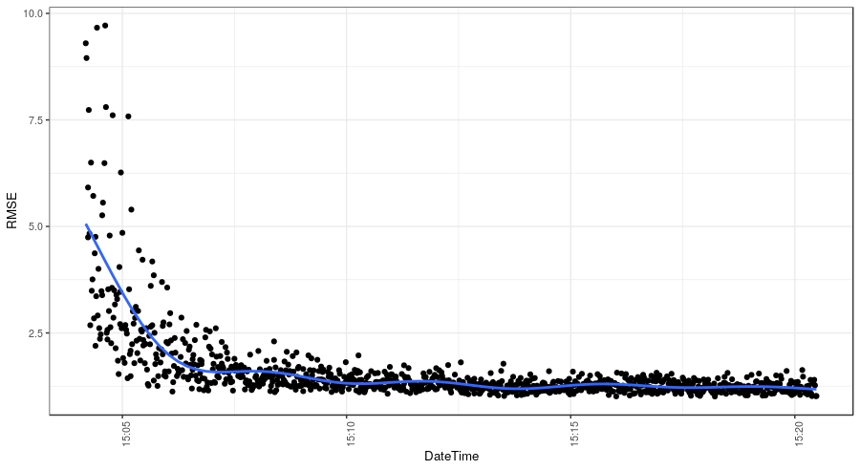
glmtools: calibration
get_calib_periods(): calibration
Template: your specific lake file
glm3.nml
glm4.nml
validation
get_calib_setup(): variables
Overwritten by algorithm
glm3.nml
Best variable values
Variable values + fit (RMSE)
CSV

Slide 34
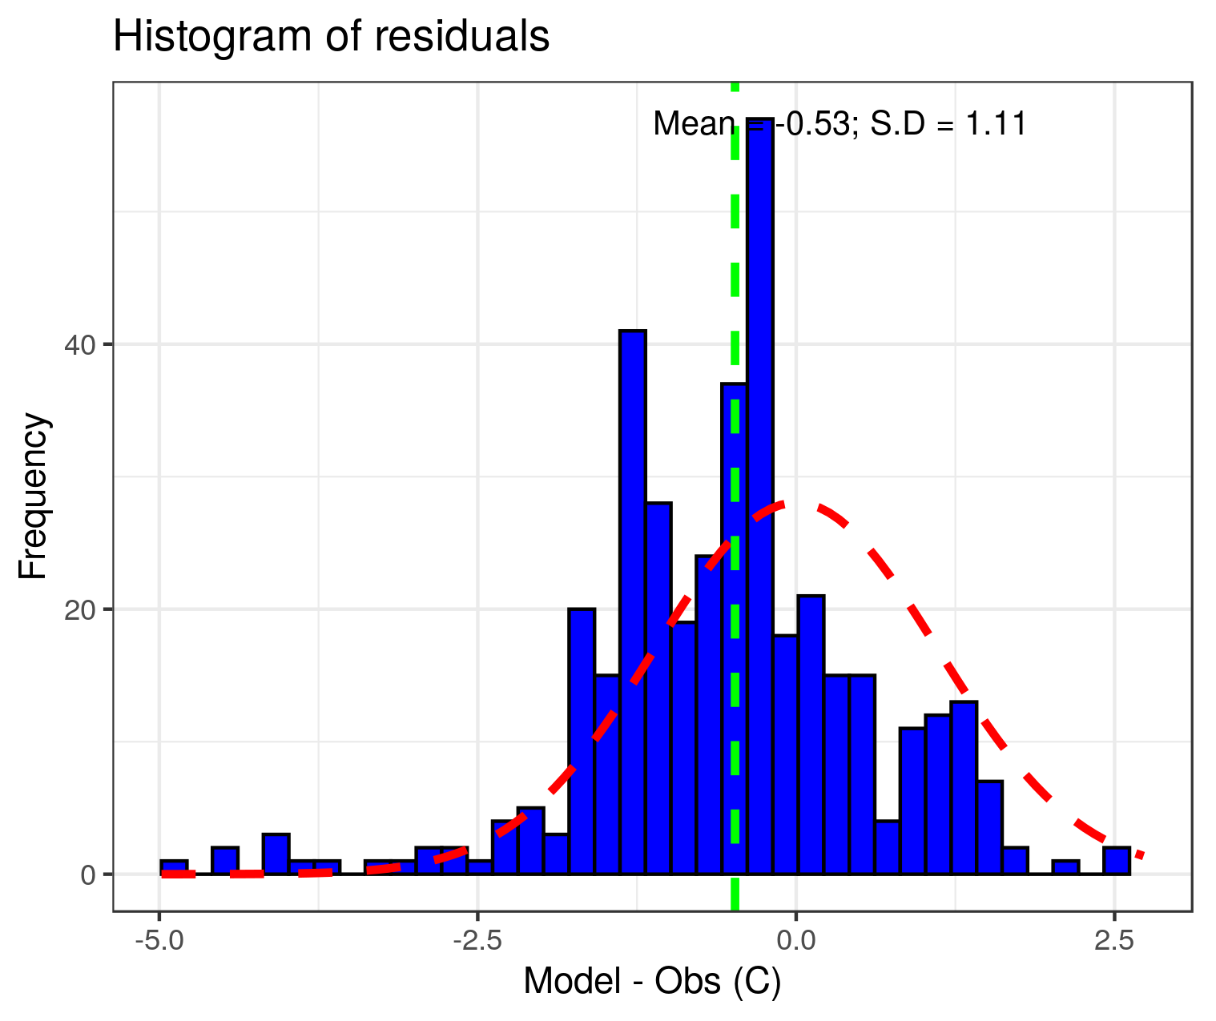
glmtools: calibration
Calibration and validation as best practice
Easy automatic calibration instead of manual tinkering
Stored values in CSV give conclusions about parameter space
Easier documentation

Slide 35
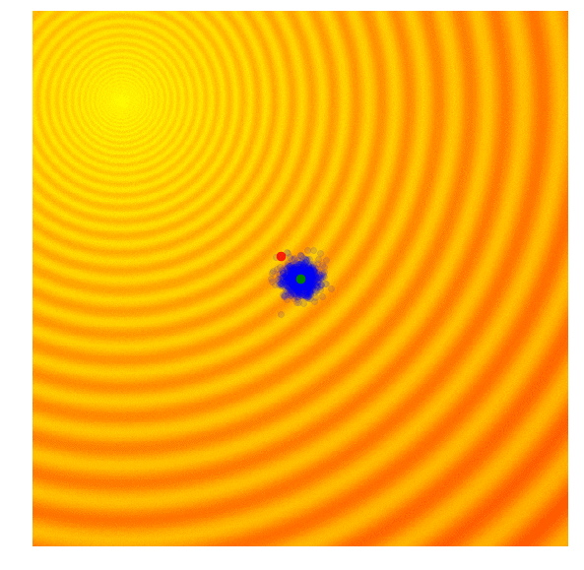
Evolutionary optimization (default)
Optimization criteria: minimize RMSE between observed and modeled water temperatures
CMA-ES (Hansen 2006)
Covariance Matrix Adaption - Evolution Strategy
Derivative-free optimization
Adaptively changes the search path for every generation (modifying normal distribution and covariance matrix)
Covers wide search space, converges fast but needs more computational time (O(N²))
Stops after reaching certain RMSE (default 1.5 ℃) or doing a finite amount of iterations (default is 150)
Visual example (link)

Slide 36
Visualize and calibrate GLM in R

Slide 37
GLM R-Packages
Distributed computing system
Run multiple GLM simulations
e.g. scenario modeling
GRAPLEr
glmtools
GLM3r
Change model setup
Visualize results
Physical derivatives
Calibration
Runs GLM in R (version 3.0.5)

Slide 38
GRAPLEr
PRAGMA+GLEON inter-disciplinary expedition
http://graple.org
Objective: allows you to run 1000s of GLM jobs
Dispatch to different computers across the Internet
Shorten execution times for large numbers of runs
Distributed computing is not easy
GRAPLEr aims to facilitate access and use
Can submit jobs directly from R user interface

Slide 39


GRAPLEr under the hood
receive
Web service
HTCondor
send
Internet
You,
keyboard
R, plus
GRAPLEr
library
IPOP
overlay
network
UF
VT
GRAPLEr
UW
Other sites

Slide 40
GRAPLEr Workflows
Prepare GLM inputs to create an experiment
.nml, .csv driver files
Create your own inputs on your computer, or have GRAPLEr generate your inputs
E.g. add a random number between 0, 2 degrees Celsius to AirTemp, from a uniform distribution; add a constant, linear offset
Optionally, add a post-processing filter (to reduce size of output)
Submit experiment
From R, R-Studio
Wait for completion, and download outputs

Slide 41

GLM R-Packages and where to find them
github
GRAPLE/GRAPLEr
library(devtools)
devtools::install_github()
Development version from hdugan/glmtools will soon be merged into official repository
USGS-R/glmtools
GLEON/GLM3r

Slide 42
Break

Slide 43
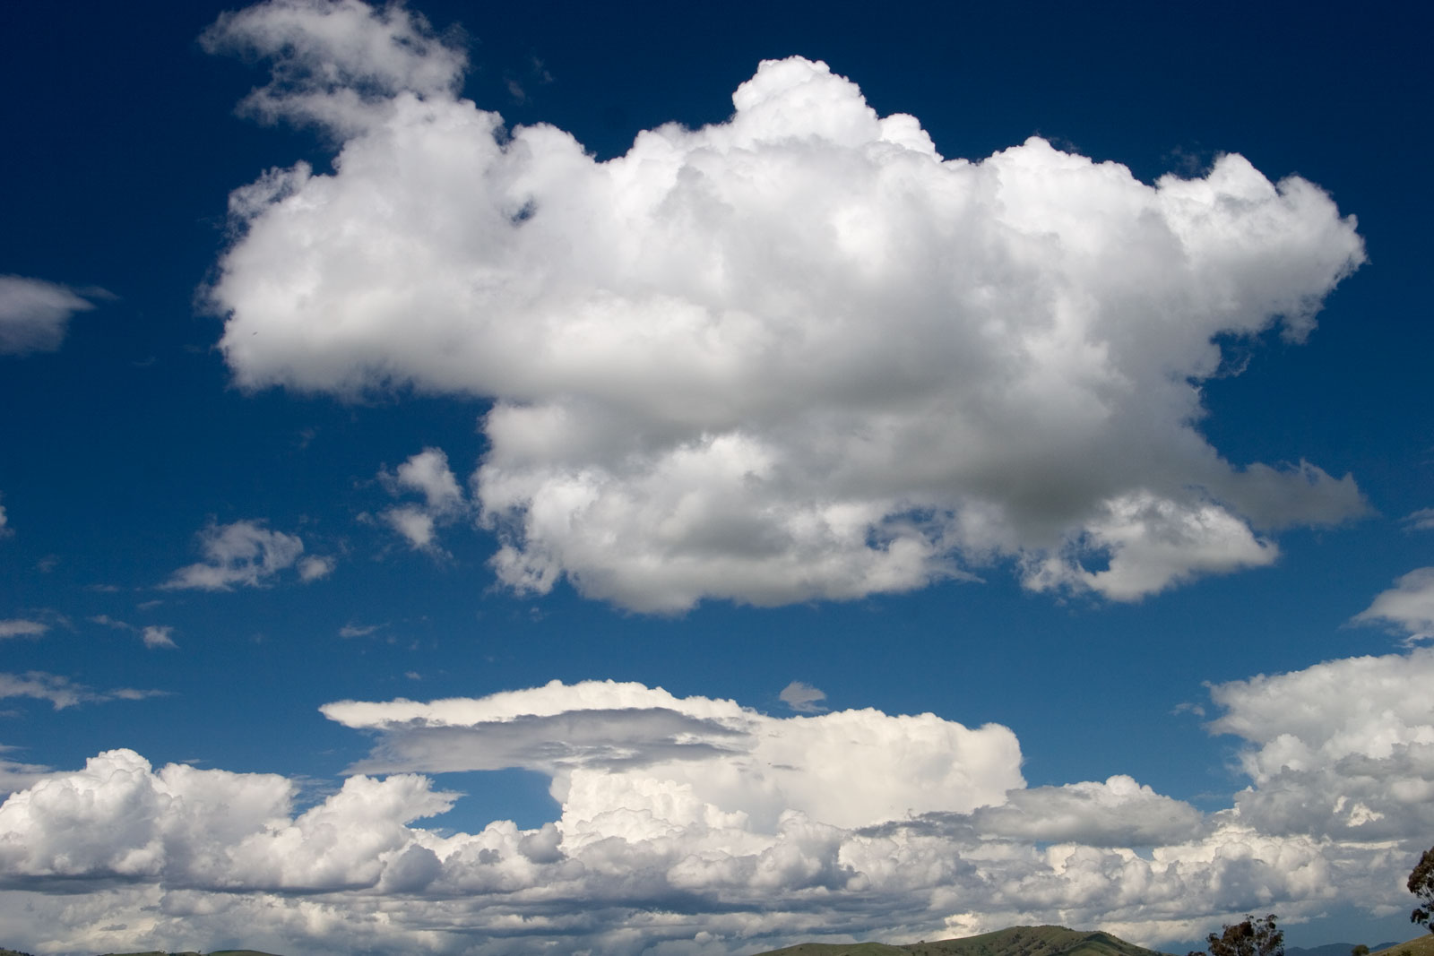
Future development
“Containerized” GLM:
Containers are standardized units of software (include code and dependencies)
standalone executable package
not depending on operating system
GLM-AED2 is available at dockerhub (hydrobert/glm-aed2)
Can be used in R: https://github.com/robertladwig/GLM_docker
Online-GLM: columbus4limnology.io
Share data and run GLM in the cloud!
This Photo by Unknown Author is licensed under CC BY-SA

Slide 44
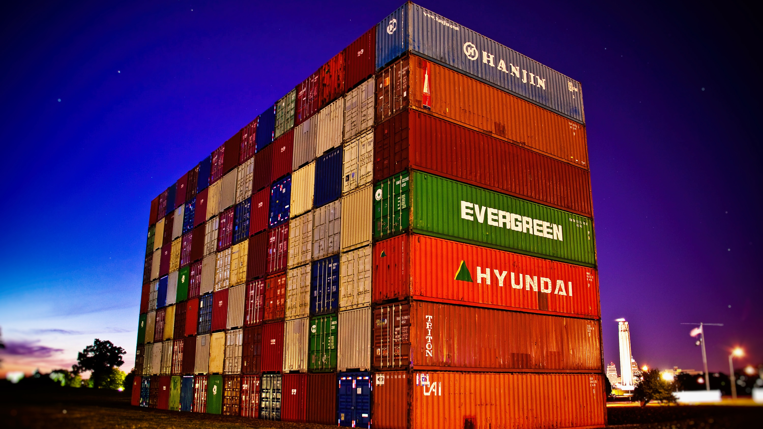
Demonstration

Slide 45
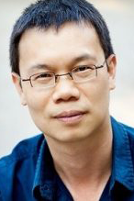
columbus4limnology.io
AnHai Doan
Prof. @ CS
UW-Madison
And his team, Amanpreet Singh Saini and Kaushik Chandrasekhar.
Funding in part through UW Data Science Initiative

Slide 46
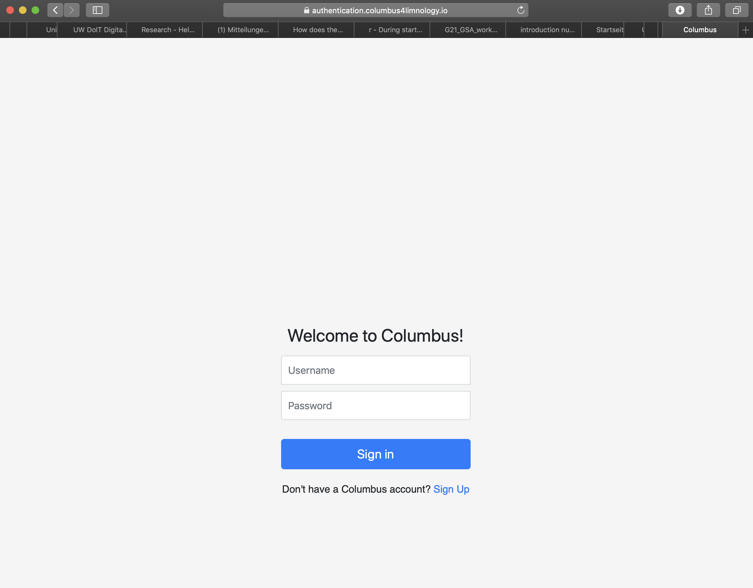
Create an account

Slide 47
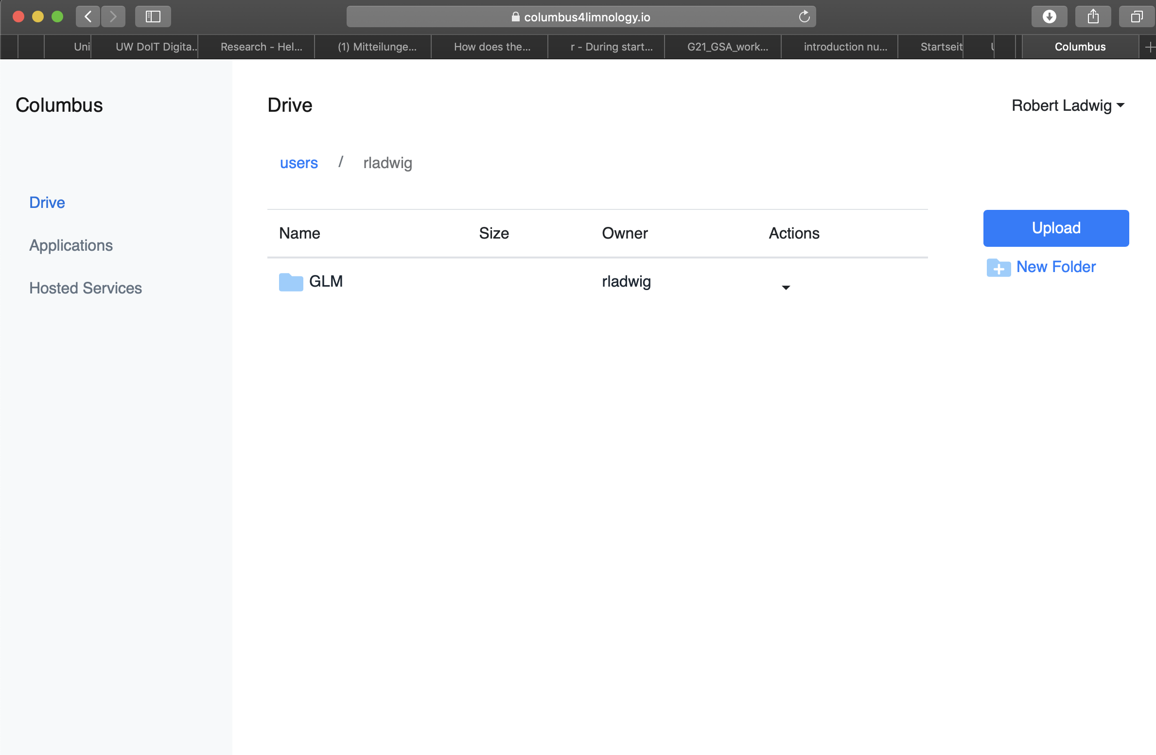
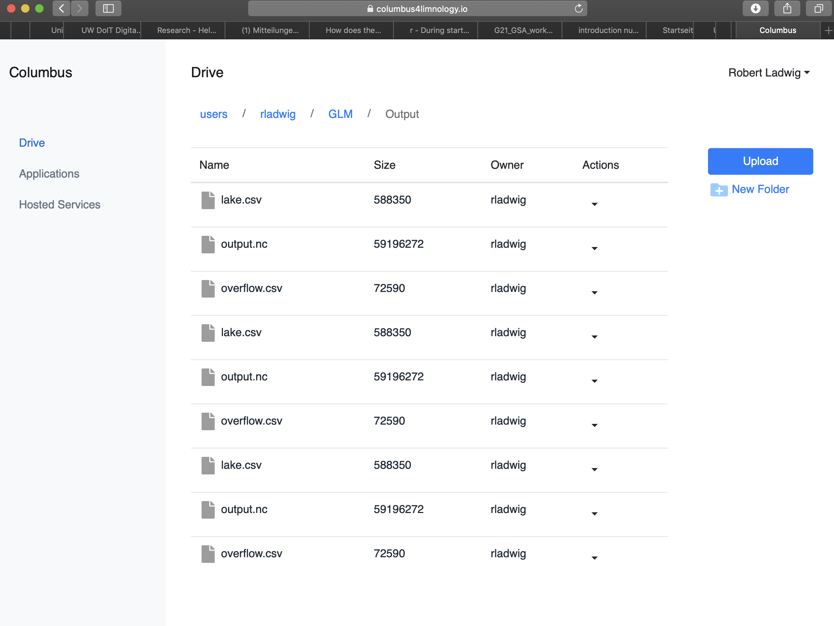
Upload your model setup

Slide 48
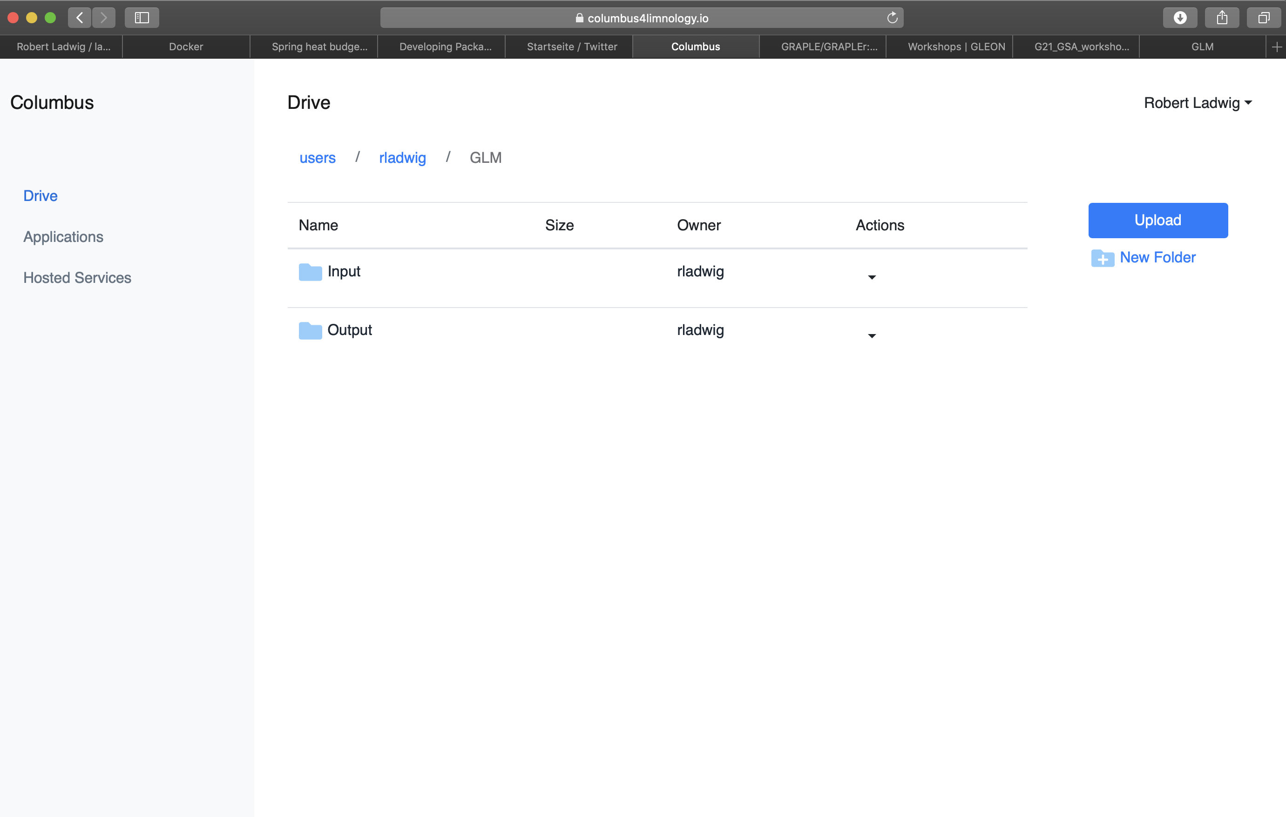
Have two folders

Slide 49
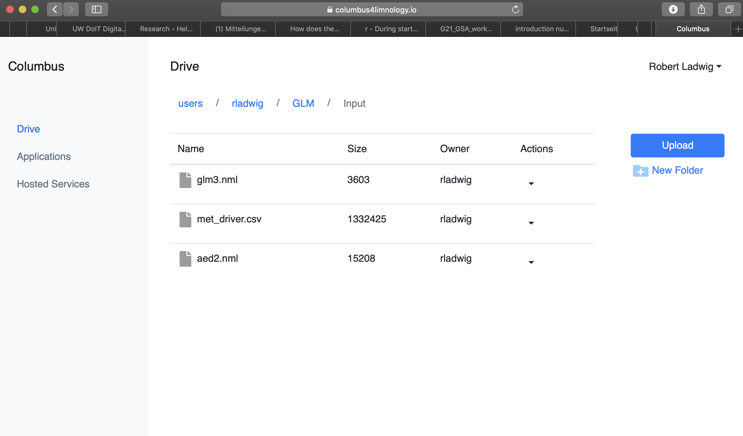
You’ll need a glm3.nml file and driver data

Slide 50
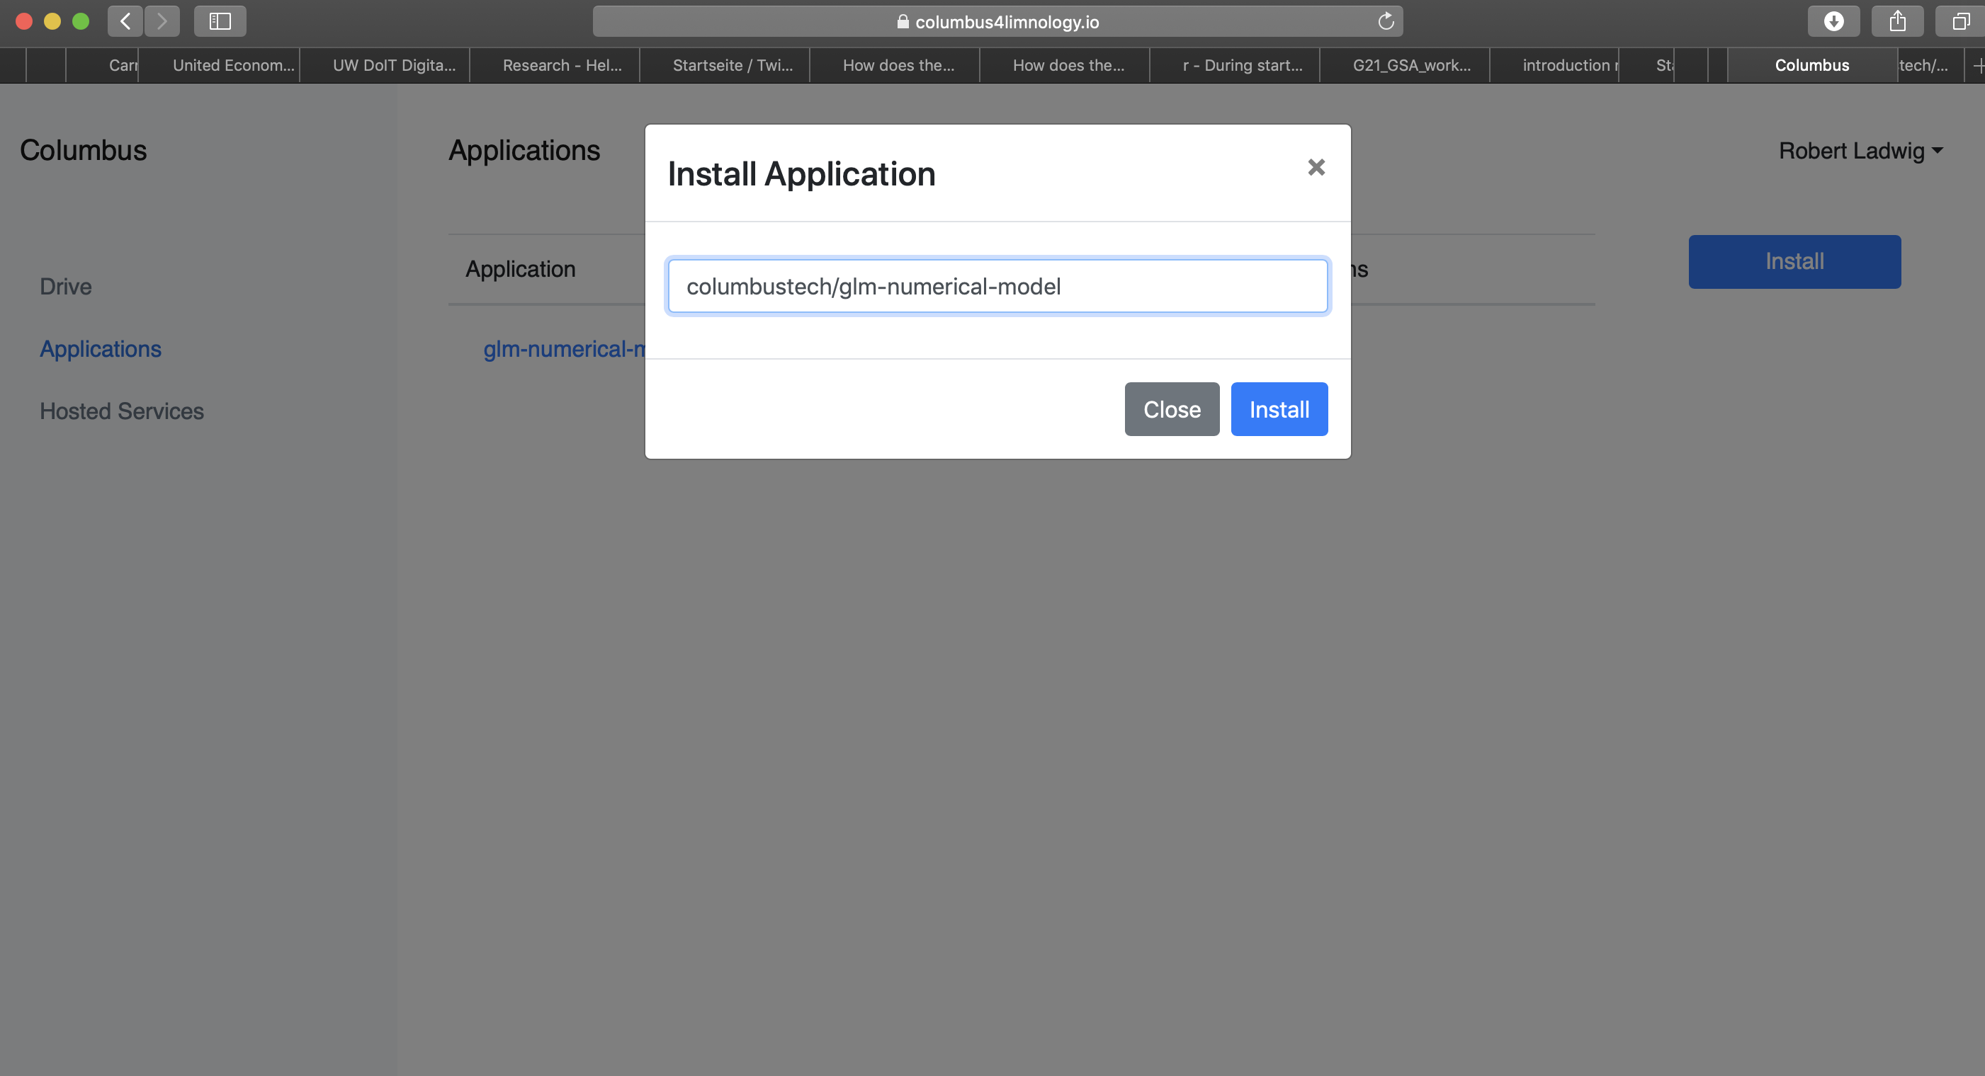
Install the docker container

Slide 51
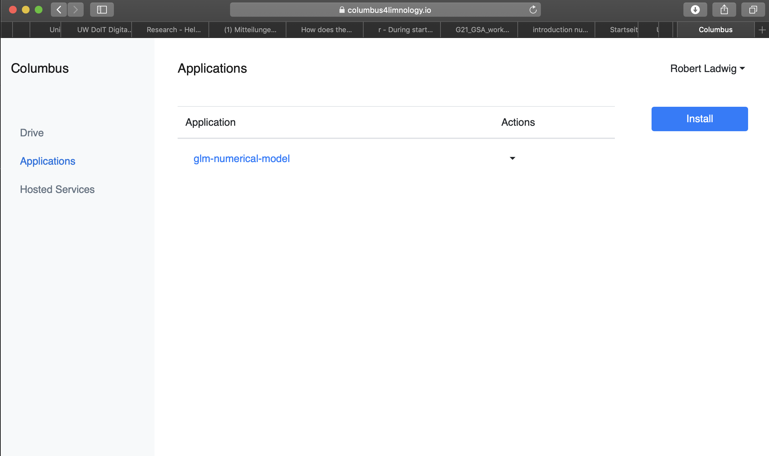
Click on the application

Slide 52
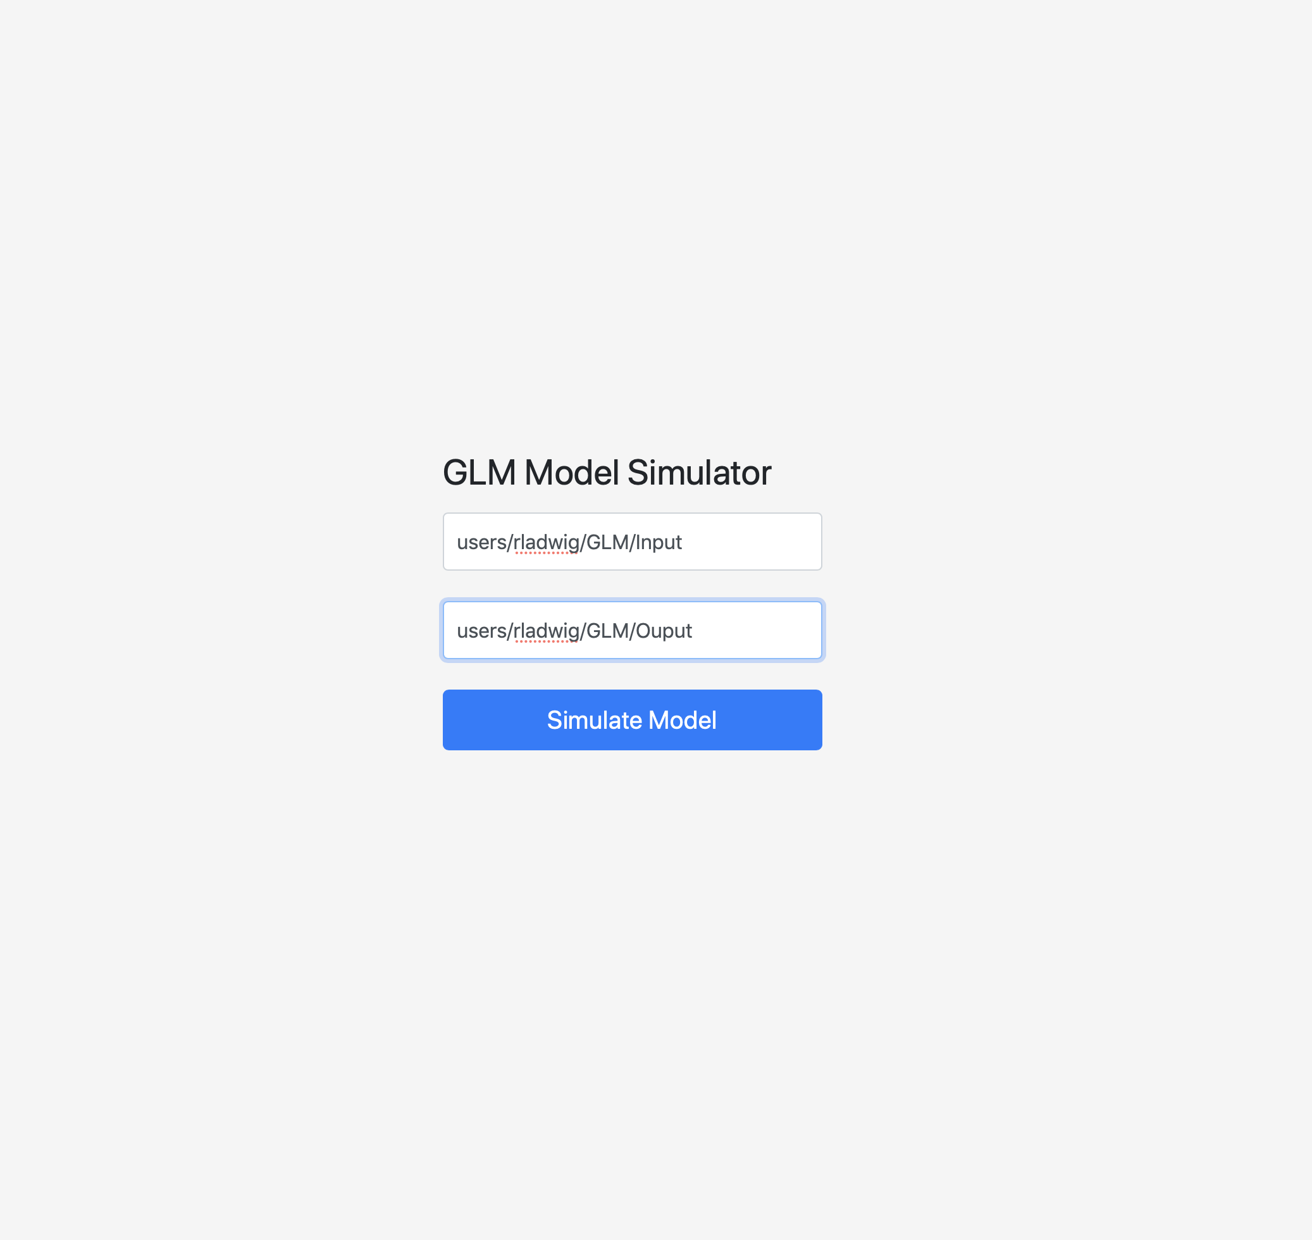
Type in the input and output paths

Slide 53
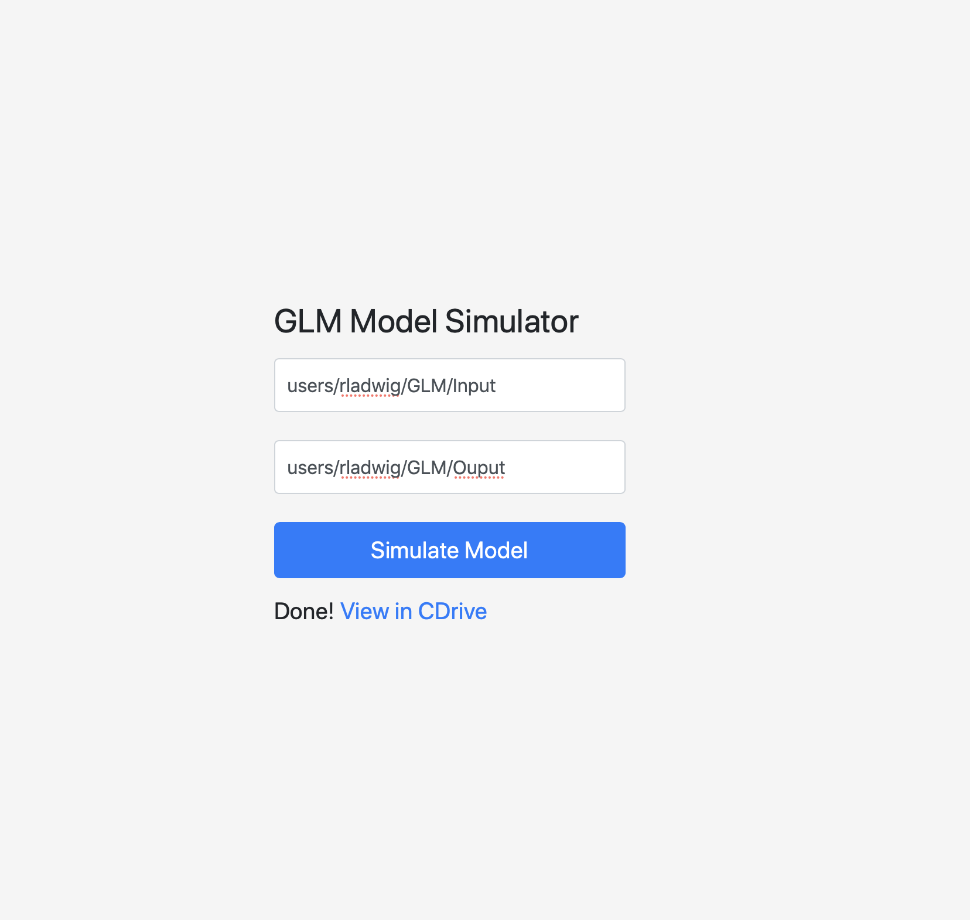
Simulate model

Slide 54
Download the output

Slide 55
columbus4limnology.io
This Photo by Unknown Author is licensed under CC BY-SA
Feel free to create an account and to run GLM simulations in the cloud!
You can share your model data with other users
Hopefully this will enhance collaborations, and will help in finding mistakes in the model setup
Containerized GLM could be a very flexible tool

Slide 56

Join the GLM community
Find latest source code at https://github.com/AquaticEcoDynamics/GLM
Here, you can raise issues (errors, compilation problems, suggestions, improvements, bugs)
Old: google group (forum) https://groups.google.com/forum/#!categories/aquaticmodelling/glm
New: slack

Slide 57





Join
Network for early career scientists
Focus on modeling of aquatic ecosystems
Annual workshops (Australia, Ireland)
Meeting during GLEON
Join our slack to find collaborations, ask questions and complain about research

Slide 58


Next workshop
ASLO 2020 in Madison, WI (USA)
June 7 – 12, 2020
Probably the weekend before
Travel support is possible (lodging and meals)
More information as soon as possible

Slide 59

Thank you
Find latest source code at https://github.com/AquaticEcoDynamics/GLM
Here, you can raise issues (errors, compilation problems, suggestions, improvements, bugs)
Join GLM slack to ask questions and get

